Slide 1
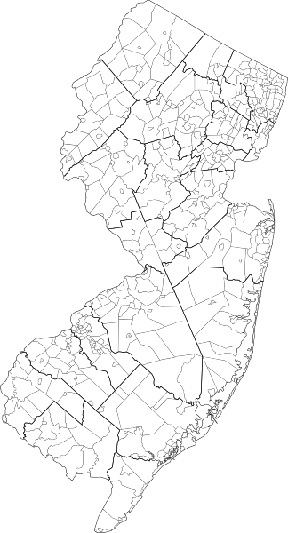


Building Strong Communities
State & Federal Investments Available To Support Your Projects

Slide 2
INTRODUCTION TO NJDCA
The New Jersey Department of Community Affairs (DCA) is a State agency created to provide administrative guidance, financial support and technical assistance to local governments, community development organizations, businesses and individuals to improve the quality of life in New Jersey.
DCA offers a wide range of programs and services that respond to issues of public concern including fire and building safety, housing production, community planning and development, and local government management and finance.

Slide 3


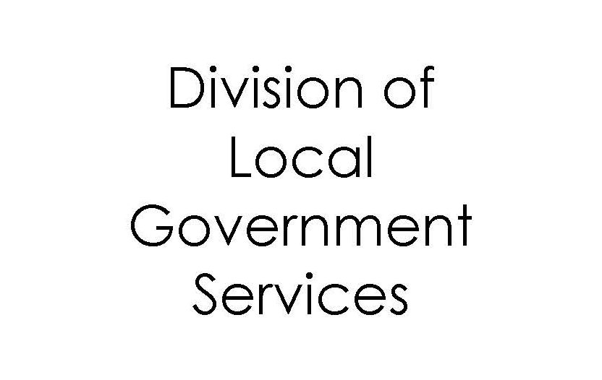
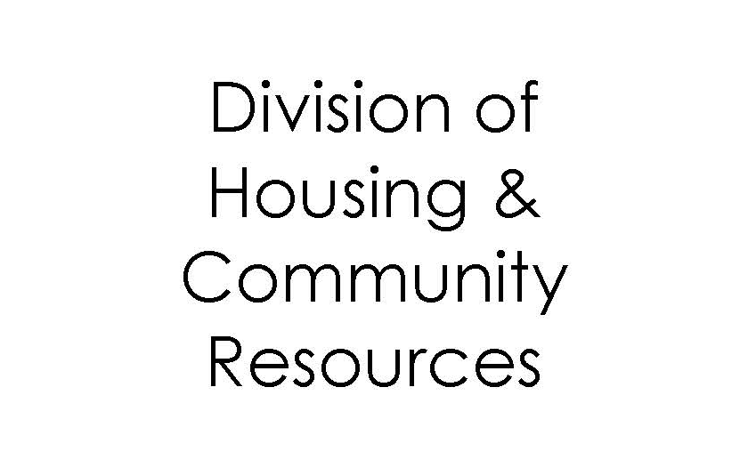






NJDCA DIVISIONS
& Affiliates
Local Planning Services
Divisions
Affiliates

Slide 4
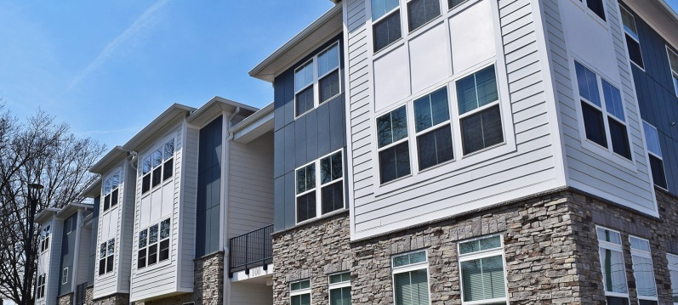
FUNDING PROGRAMS
Division of Housing & Community Resources

Slide 5
FUNDING
2016-2022

Slide 6
CDBG
SMALL CITIES
Public Facilities
Housing Rehabilitation
Innovation & Economic Development
Emergency Housing Repair
Maximum Award: approx. $400,000

Slide 7
HOME
TBRA
Tenant-Based Rental Assistance Program
HPI & CHDO
Housing Production Programs for the Acquisition, Construction and/or Rehabilitation of up to 11 Units of low- and moderate-income housing
Maximum Award: $6,000,000

Slide 8
HOME ARP
PRIORITIES
Housing Production
Supportive Services
Homelessness Prevention/Housing Counseling Services
Preservation of Existing Housing
Tenant-Based Rental Assistance
Non-Congregate Shelter

Slide 9
ESG
SHELTER SUPPORT
Emergency Shelter
Transitional Housing
Equipment, Furnishing & Vehicles
Maximum Award: $450,000

Slide 10
HOPWA
Housing assistance & supportive services for persons living with HIV/AIDS
Assisted households pay 30% of adjusted monthly income (Voucher)
State/DHSS: Atlantic, Cape May, Cumberland, Mercer, Salem and Warren counties

Slide 11
RHP
PILOT PROGRAM
Temporary Housing for individuals in recovery from substance use disorder for 18-24
State Allocation Only
5 Counties: Atlantic, Camden, Essex, Monmouth or Ocean counties
Class F License (Cooperative Sober Living Residences)
Maximum Award: $600,000

Slide 12
NHTF
For the acquisition, construction or rehabilitation of up to 4 Rental Units for extremely low-income special needs households (<30% of AMI), which are paired with Project Based Vouchers.
Maximum Award: $1,000,000

Slide 13
AHTF
Housing Production Program for the Acquisition, Construction and/or Rehabilitation of up to 25 Units of low- and moderate-income housing
Maximum Award: approx. $6,000,000

Slide 14

NRTC
PLANNING & IMPLEMENTATION
100% Tax Credit
Awards to projects in neighborhoods with approved NRTC Plans
Recently Approved 21 New NRTC Plans
Maximum Award: $1,000,000 (Project)

Slide 15
SECTION 8 & HPP
HCV/PBV (including ERAP I & 2)
Family Self-Sufficiency
SRAP
Section 8 SRO / Section 8 Homeownership
HPP
Rapid Re-Housing
ATC & Anti-Eviction Diversion Program
Eviction Prevention Program

Slide 16
CSBG
provision of health, education, employment and housing and other services to individuals and families with low incomes in New Jersey.
This work is performed by 25 agencies throughout the state whom are designated as Community Action Agencies (CAAs).

Slide 17
ENERGY ASSISTANCE
HEA/LIHEAP/LIHWAP
USF
Weatherization Assistance Program (WAP)
Lead-Safe Home Remediation Pilot

Slide 18
PROGRAM FUNDING
2016-2022
*Not including Section 8/HPP/CSBG/Energy Assistance

Slide 19
OTHER NJDCA RESOURCES
NPP: Community & Economic Development Funding & Technical Assistance
SHC: DHS/DCA Partnership to administer DHS Rental Subsidies
LPS: Planning & Redevelopment Planning Technical Assistance & Funds for Qualifying Municipalities
LGS: Planning & Implementation Shared Services Grants
NJHT: Historic Trust Grants & Preservation Funds
NJRA: Pre-development & Acquisition Programs
NJHMFA: LIHTC (AHGS), AHPF, SNHTF, Downpayment Assistance, Foreclosure Mediation, etc.

Slide 20
COUNTY & LOCAL RESOURCES
MUNICIPAL PJS: CDBG, HOME, ESG, HOPWA
URBAN COUNTY PJS & CONSORTIUMS: CDBG, HOME & ESG
LOCAL CARES & ARP: Allocation By PJ (see HUD Website)

Slide 21
OTHER LOCAL RESOURCES
Local AHTF
    Rehab Programs (Substantial & Intermediate Rehab)
    Buy-Down Programs
    Accessory Dwelling Units (ADUs)
Local Planning & Zoning
    Redevelopment & Rehabilitation Areas
    PILOTS, Abatements (Short-Term 5-Year) & Exemption (LTTE)

Slide 22
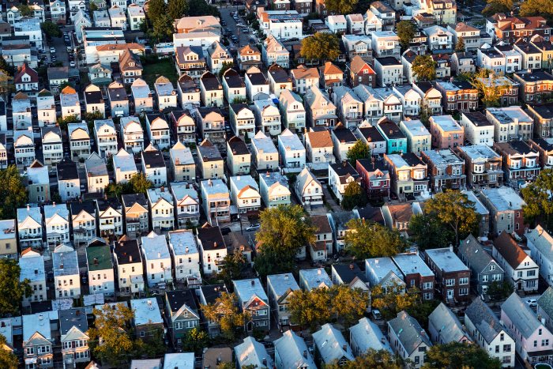
THANK YOU
For Your Commitment to Affordable Housing

