Slide 1

Legislative Day 2024
Building Up Communities. Breaking Down Barriers

Slide 2
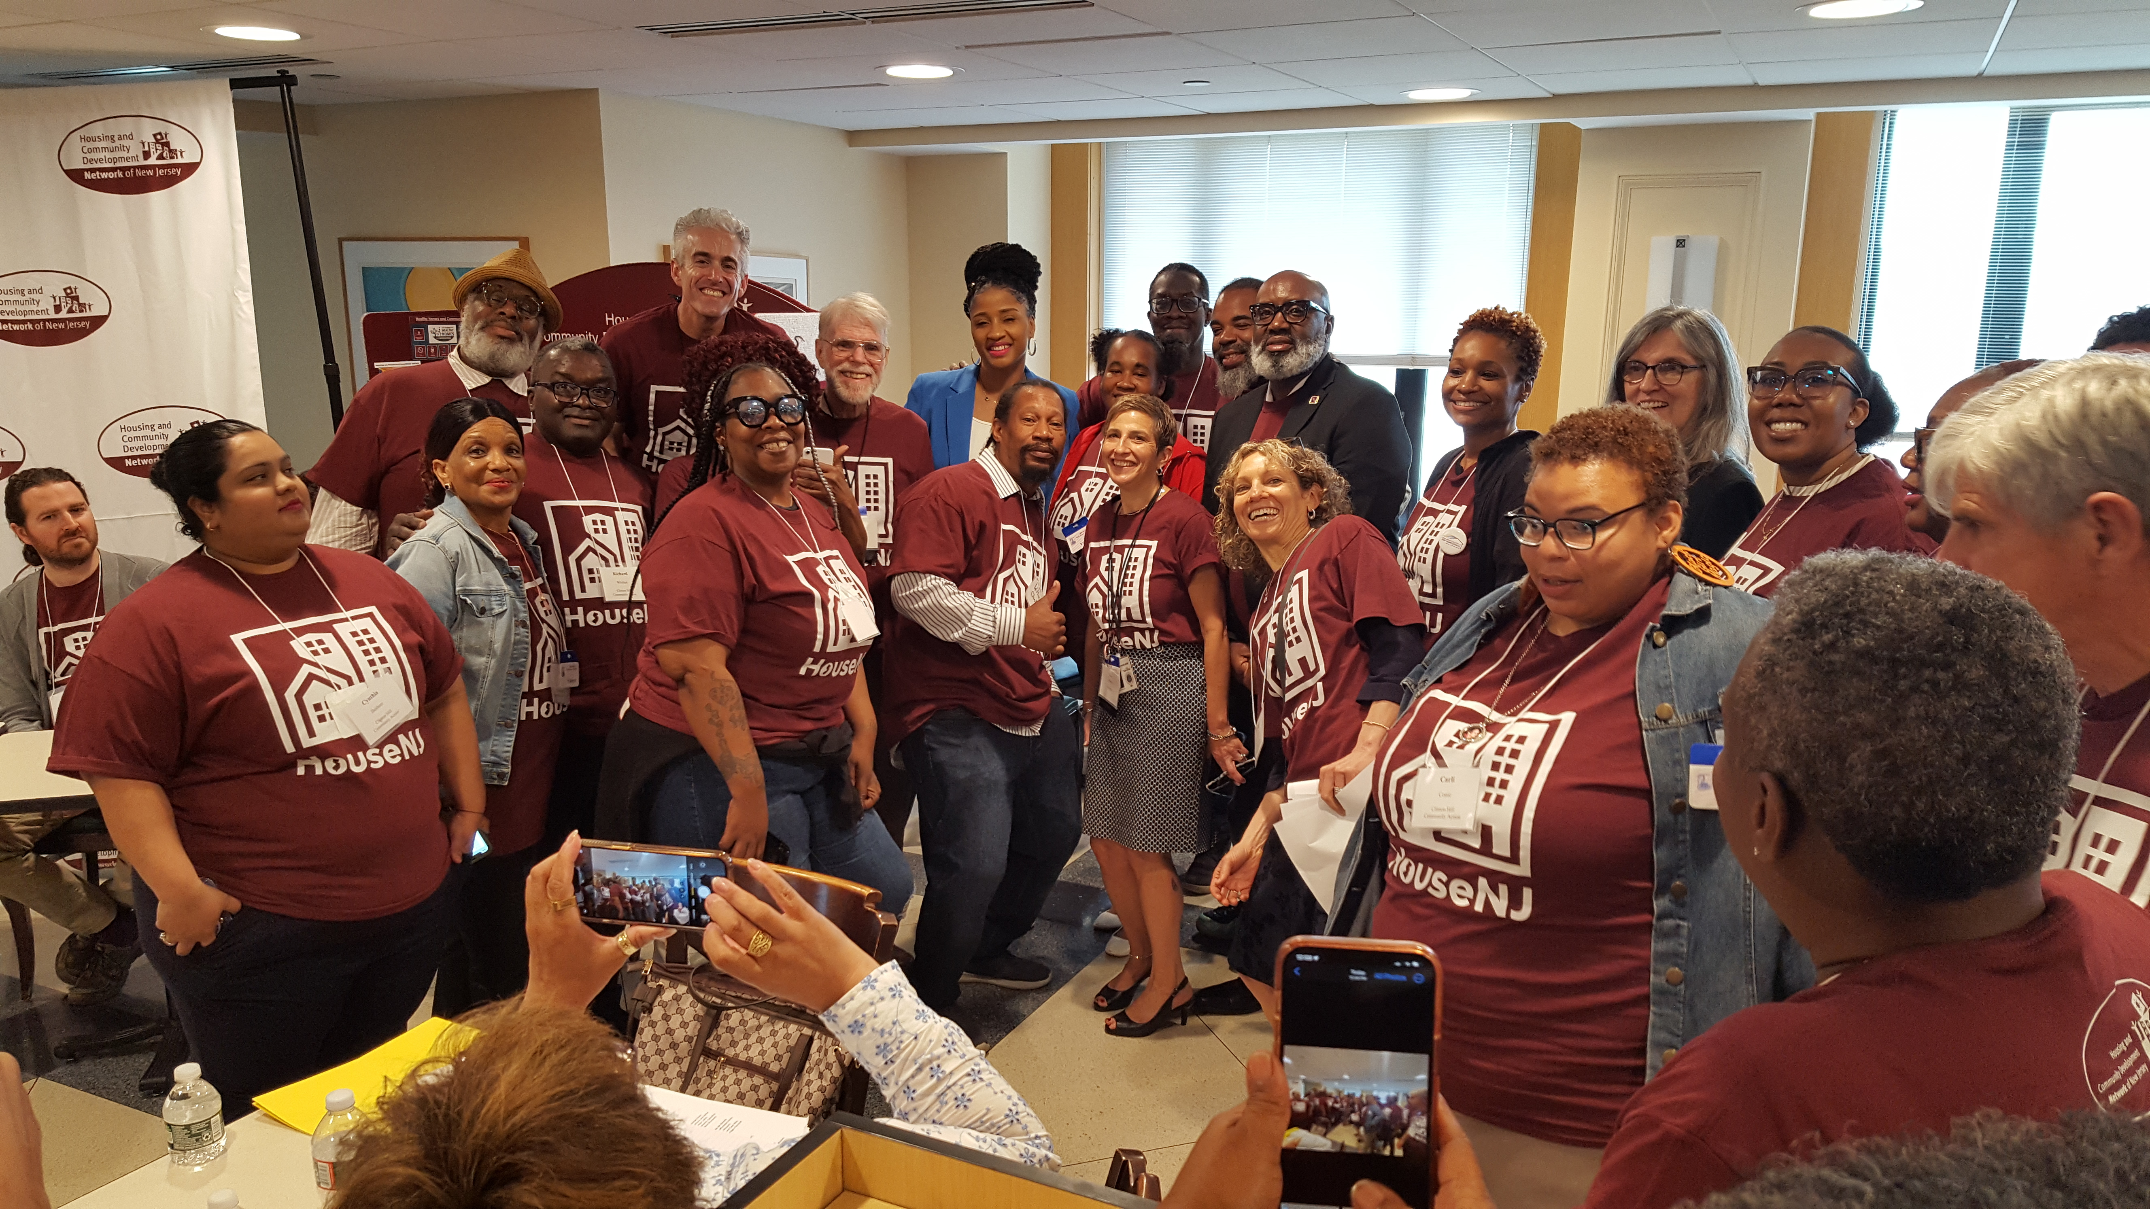
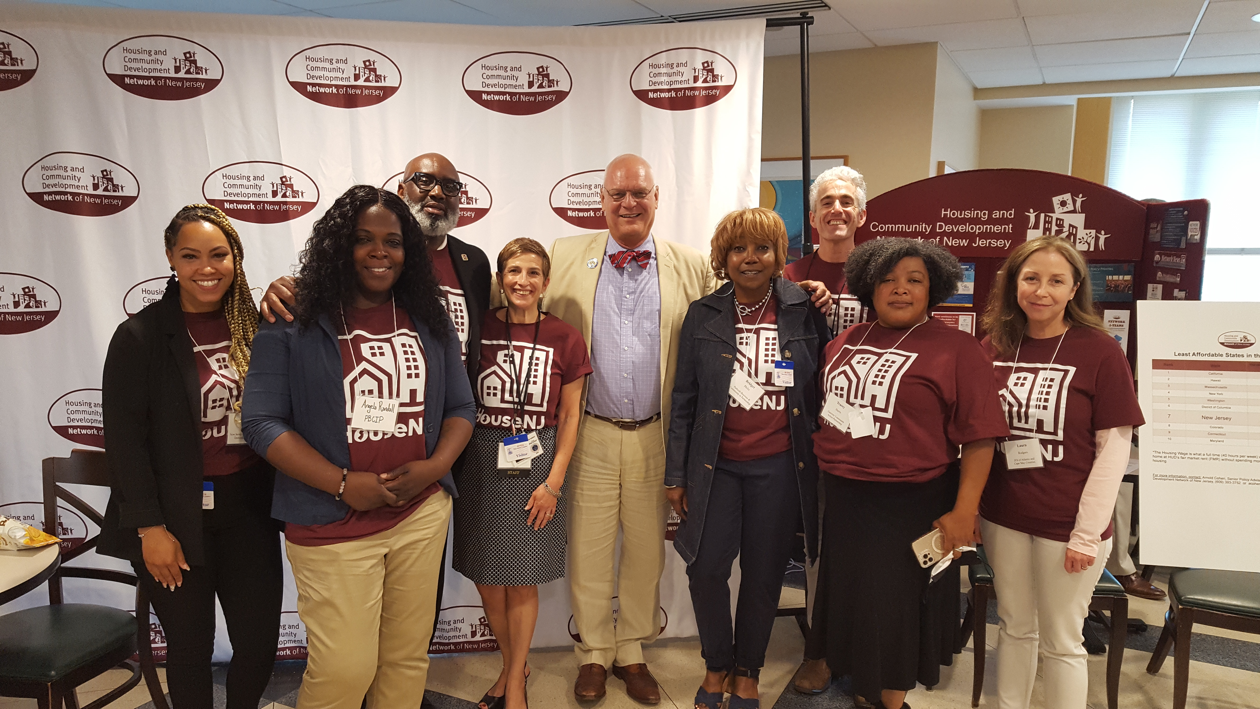
Legislative Day Is June 13, 2024!
The Network's Legislative Day returns to the State House in Trenton on Thursday, June 13! Learn more about the issues affecting NJ's community development sector and solutions we are working on to implement through our current legislative priorities:
  Grow the Affordable Housing Trust Fund
  Double the Neighborhood Revitalization Tax Credit Program
  Create statewide Code Red requirements
  Eliminate racial bias in property appraisal
  De-prioritize credit scores for affordable housing applicants

Slide 3
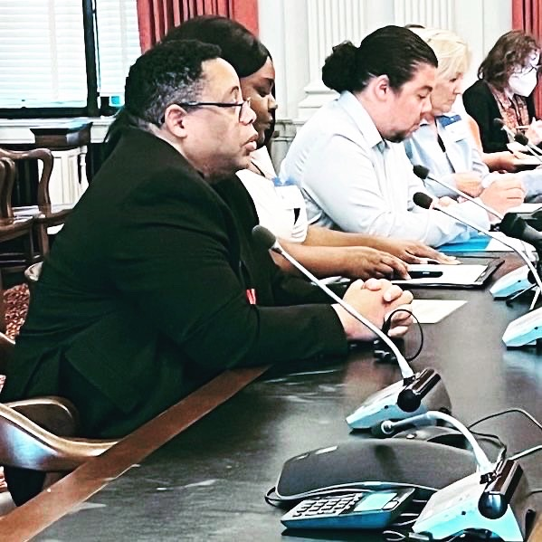
Legislative Day Is an Opportunity!
Legislative Day is an opportunity to:
  Speak with your representatives about supporting public policy that will help HouseNJ.
  Have a stronger voice by connecting with others in the housing and community development sector.
  Tour the State House and get an insider’s view of the legislative process from where it all happens.
  Hone your advocacy skills and learn tricks of the trade for communicating with decision-makers.
  Witness democracy in action by attending legislative hearings.

Slide 4
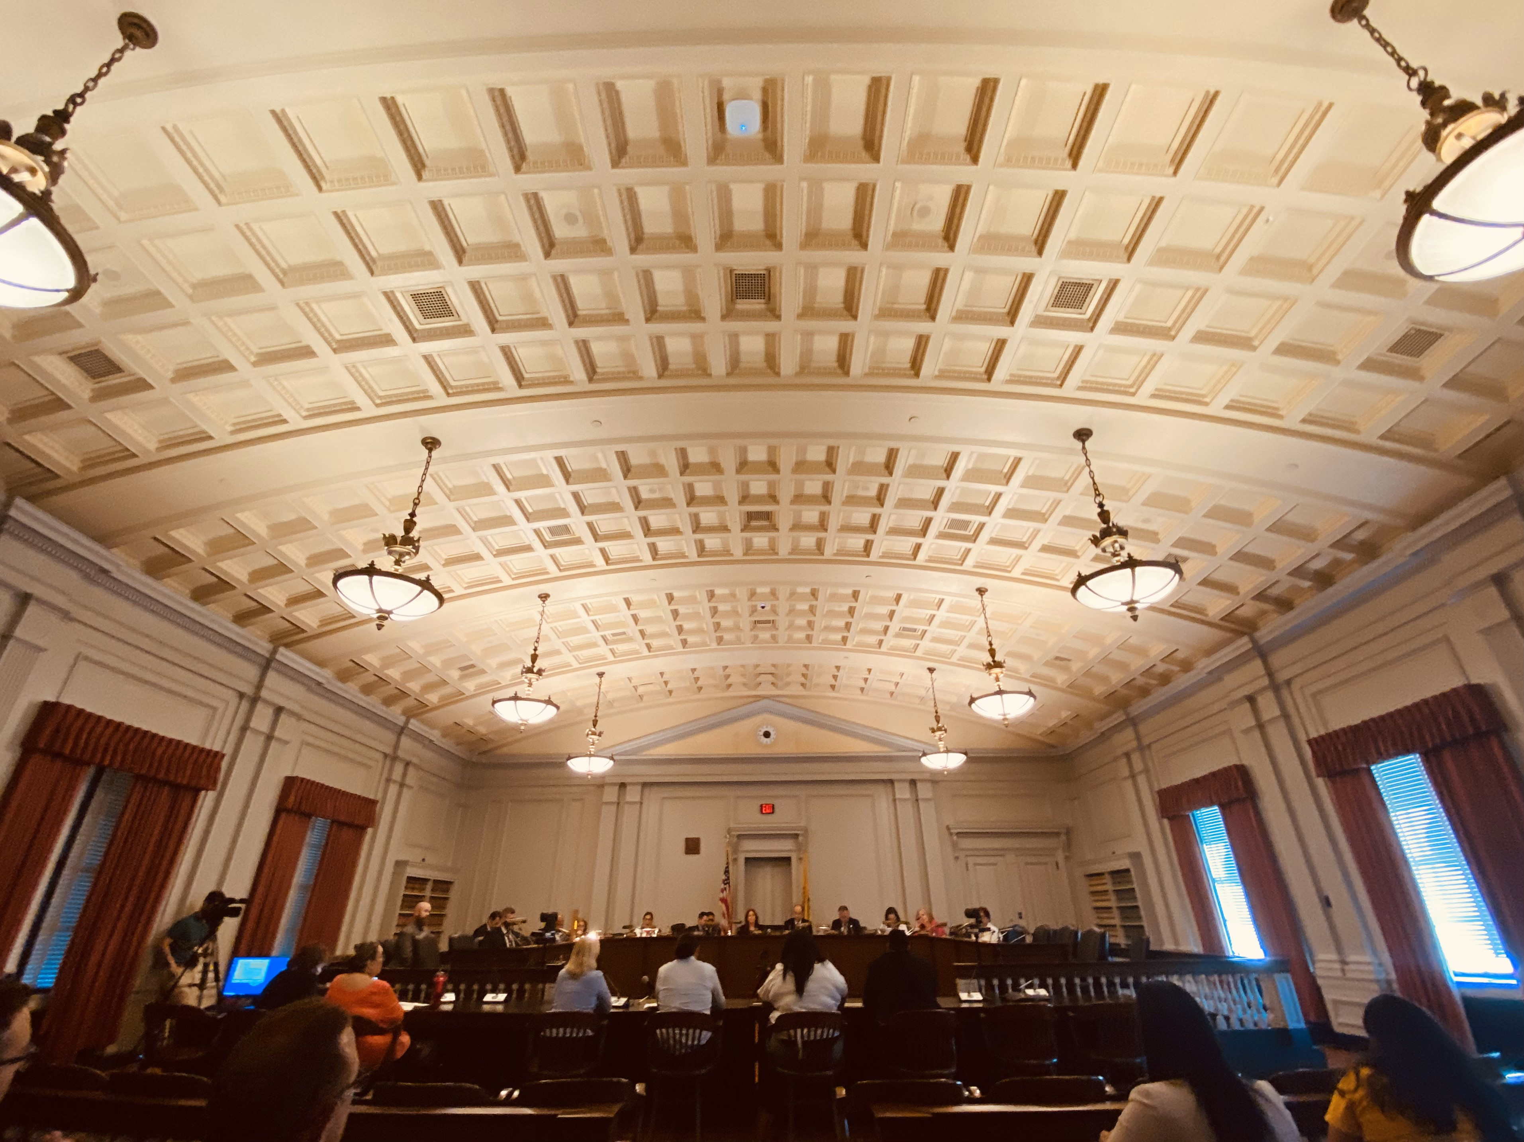
Legislative Day Advocacy
  PROTECT and GROW the Affordable Housing Trust Fund
    END EVICTIONS
    MAKE THE RENT WITHIN REACH
  DOUBLE the Neighborhood Revitalization Tax Cap – Co-sponsor resolutions S4856 and A4731
  PROTECT residents on the hottest days by PASSING Code Red, S2346/A2258
  END bias in property appraisals by PASSING S1311/A2280
  REMOVE credit scores as the entry point to an affordable home by PASSING S1501/A2838

Slide 5
FY25 Budget Advocacy –
Protect and Grow the AHTF
  BUILD MORE AFFORDABLE HOMES AND PROMOTE FIRST-TIME/FIRST-GENERATION HOMEOWNERSHIP
    With NJ’s 4th Round of Mount Laurel beginning in 2025 and with a statewide affordable home deficit of more than 200,000, NJ must Expand the Realty Transfer Fee so that is progressive and collects more revenue from the sale of very expensive homes.
    This revenue could also be used to support first time/first gen homeownership opportunities to help address our worst-in-the-nation racial wealth gap -- which is a direct result of the racial gaps in homeownership.
  THE RENT IS TOO DAMN HIGH: Enact a Luxury Landlord corporate tax because the rent is too damn high! This would be a fee on for-profit, luxury developments, that could be forgiven or refunded if the landlord provides affordable units through inclusionary zoning and/or keeps rent increases at a reasonable rate.
  MAKE EVICTORS PAY: Increase the eviction filing fee, as a disincentive/revenue raiser for eviction prevention funding.

Slide 6
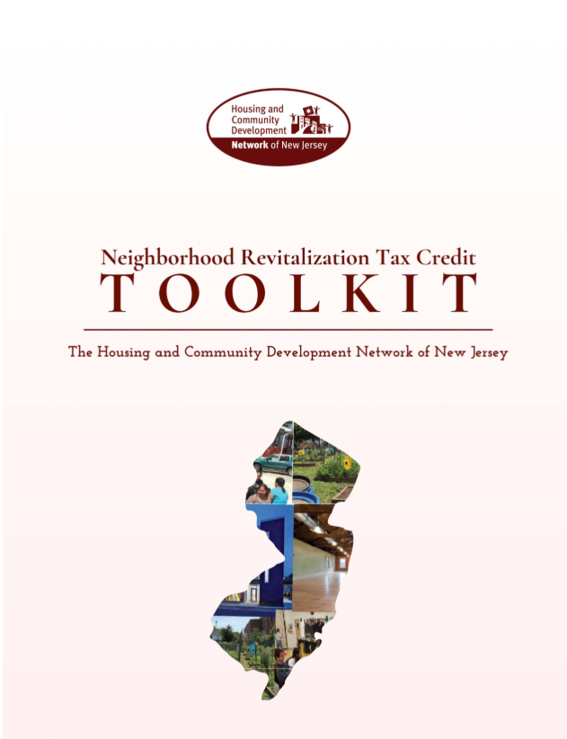
Double the Neighborhood Revitalization Tax Credit in FY2025 Budget
Leveraging $5-$7 for every dollar invested, the Neighborhood Revitalization Tax Credit (NRTC) program has become one of the most successful public/private programs furthering community development and neighborhood change in New Jersey. While the program has grown increasingly popular, it has been capped at $15M, despite rising costs and inflation.
Network members rely on the NRTC to build affordable homes and strengthen the neighborhoods they serve. Unfortunately, the program is oversubscribed and many eligible organizations are turned away because of limited funding.
It is time to double the NRTC program to $30M! Find our NRTC Advocacy Toolkit here

Slide 7
Double the Neighborhood Revitalization Tax Credit in FY2025 Budget
Network members are calling on their representatives to sign on as co-sponsors of:
  Sen. Zwicker’s NRTC Budget Resolution #4856
  Asm. Wimberly’s NRTC resolution #4731.
Both call for increasing the tax cap to $30M in FY25.

Slide 8
Legislative Priorities – Expanding Housing Security
Eliminating Bias in Property Appraisals
  S1311/A2280 (Pou/Ruiz/Lopez/Reynolds-Jackson)
  Penalizes holders of appraisal licenses or certifications, or appraisal management company registrations if they have knowingly engaged in a discriminatory appraisal of a residential property.
  Passed Assembly, March 2024; Passed Senate, May 2024; Both bills need reconciliation in Assembly (pending)
Statewide Code Red Requirements
  S2346/A2258 (Lopez/Turner/McKnight)
  Creates Code Red requirements for counties based on the state’s existing Code Blue requirements.
  Hearing Scheduled in the Assembly Housing Committee, June 2024; Assigned to Senate Health, Human Services and Senior Citizens Committee
  Last session, we were able to advocate for the bill past the Assembly Appropriations and Senate Health Committees, but both bills stalled during lame duck.
De-prioritizing Credit Scores for Affordable Housing Applicants and Recipients of State/Federal Supports
  S1501/A2838 (Verrelli/Turner)
  Establishes guidelines for creditworthiness concerning affordable housing programs
  Assigned to Senate Community and Urban Affairs Committee and Assembly Housing Committee

Slide 9
Legislative Day 2024 Agenda
8:30: Welcome, Breakfast, and Collect Materials
9:15: March to the State House to HouseNJ!
10 a.m.: Committee Hearings
11:30: Boxed Lunch Outside State House Annex
12:15: HouseNJ Rally Outside State House Annex & Group Photo
1:00: Assembly Housing Committee
ALL DAY: Constituent Meetings with Legislators

Slide 10
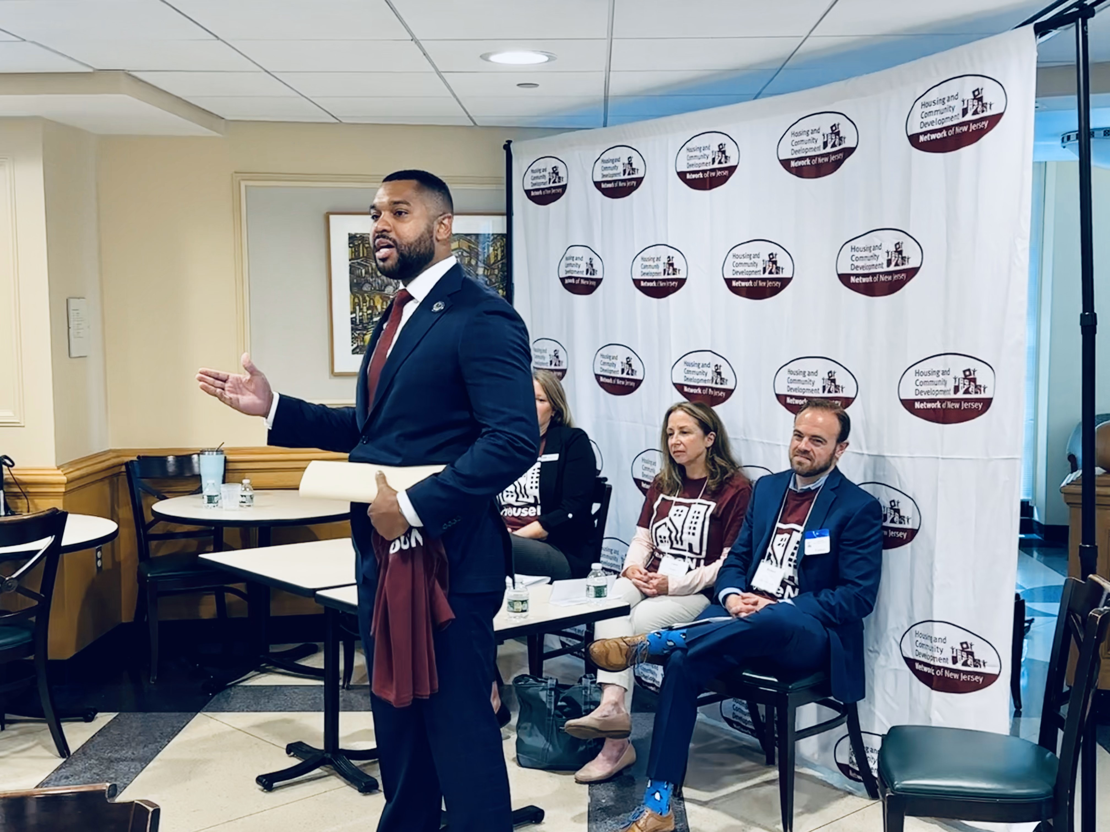
Legislative Day 2024: Committee Schedule
10 a.m.: Assembly Children, Families and Food Security – Committee Room 15, 4th Floor
10 a.m.: Assembly Financial Institutions and Insurance – Committee Room 11, 4th Floor
1 p.m.: Assembly Housing Committee -- Committee Room 9, 3rd Floor
Senate Committees Pending

Slide 11
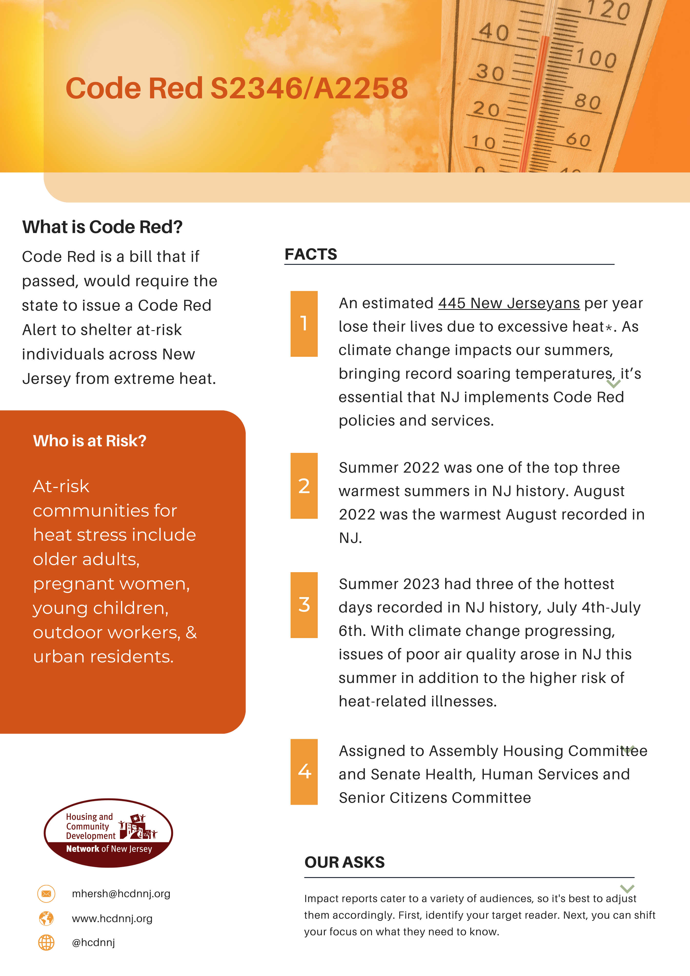
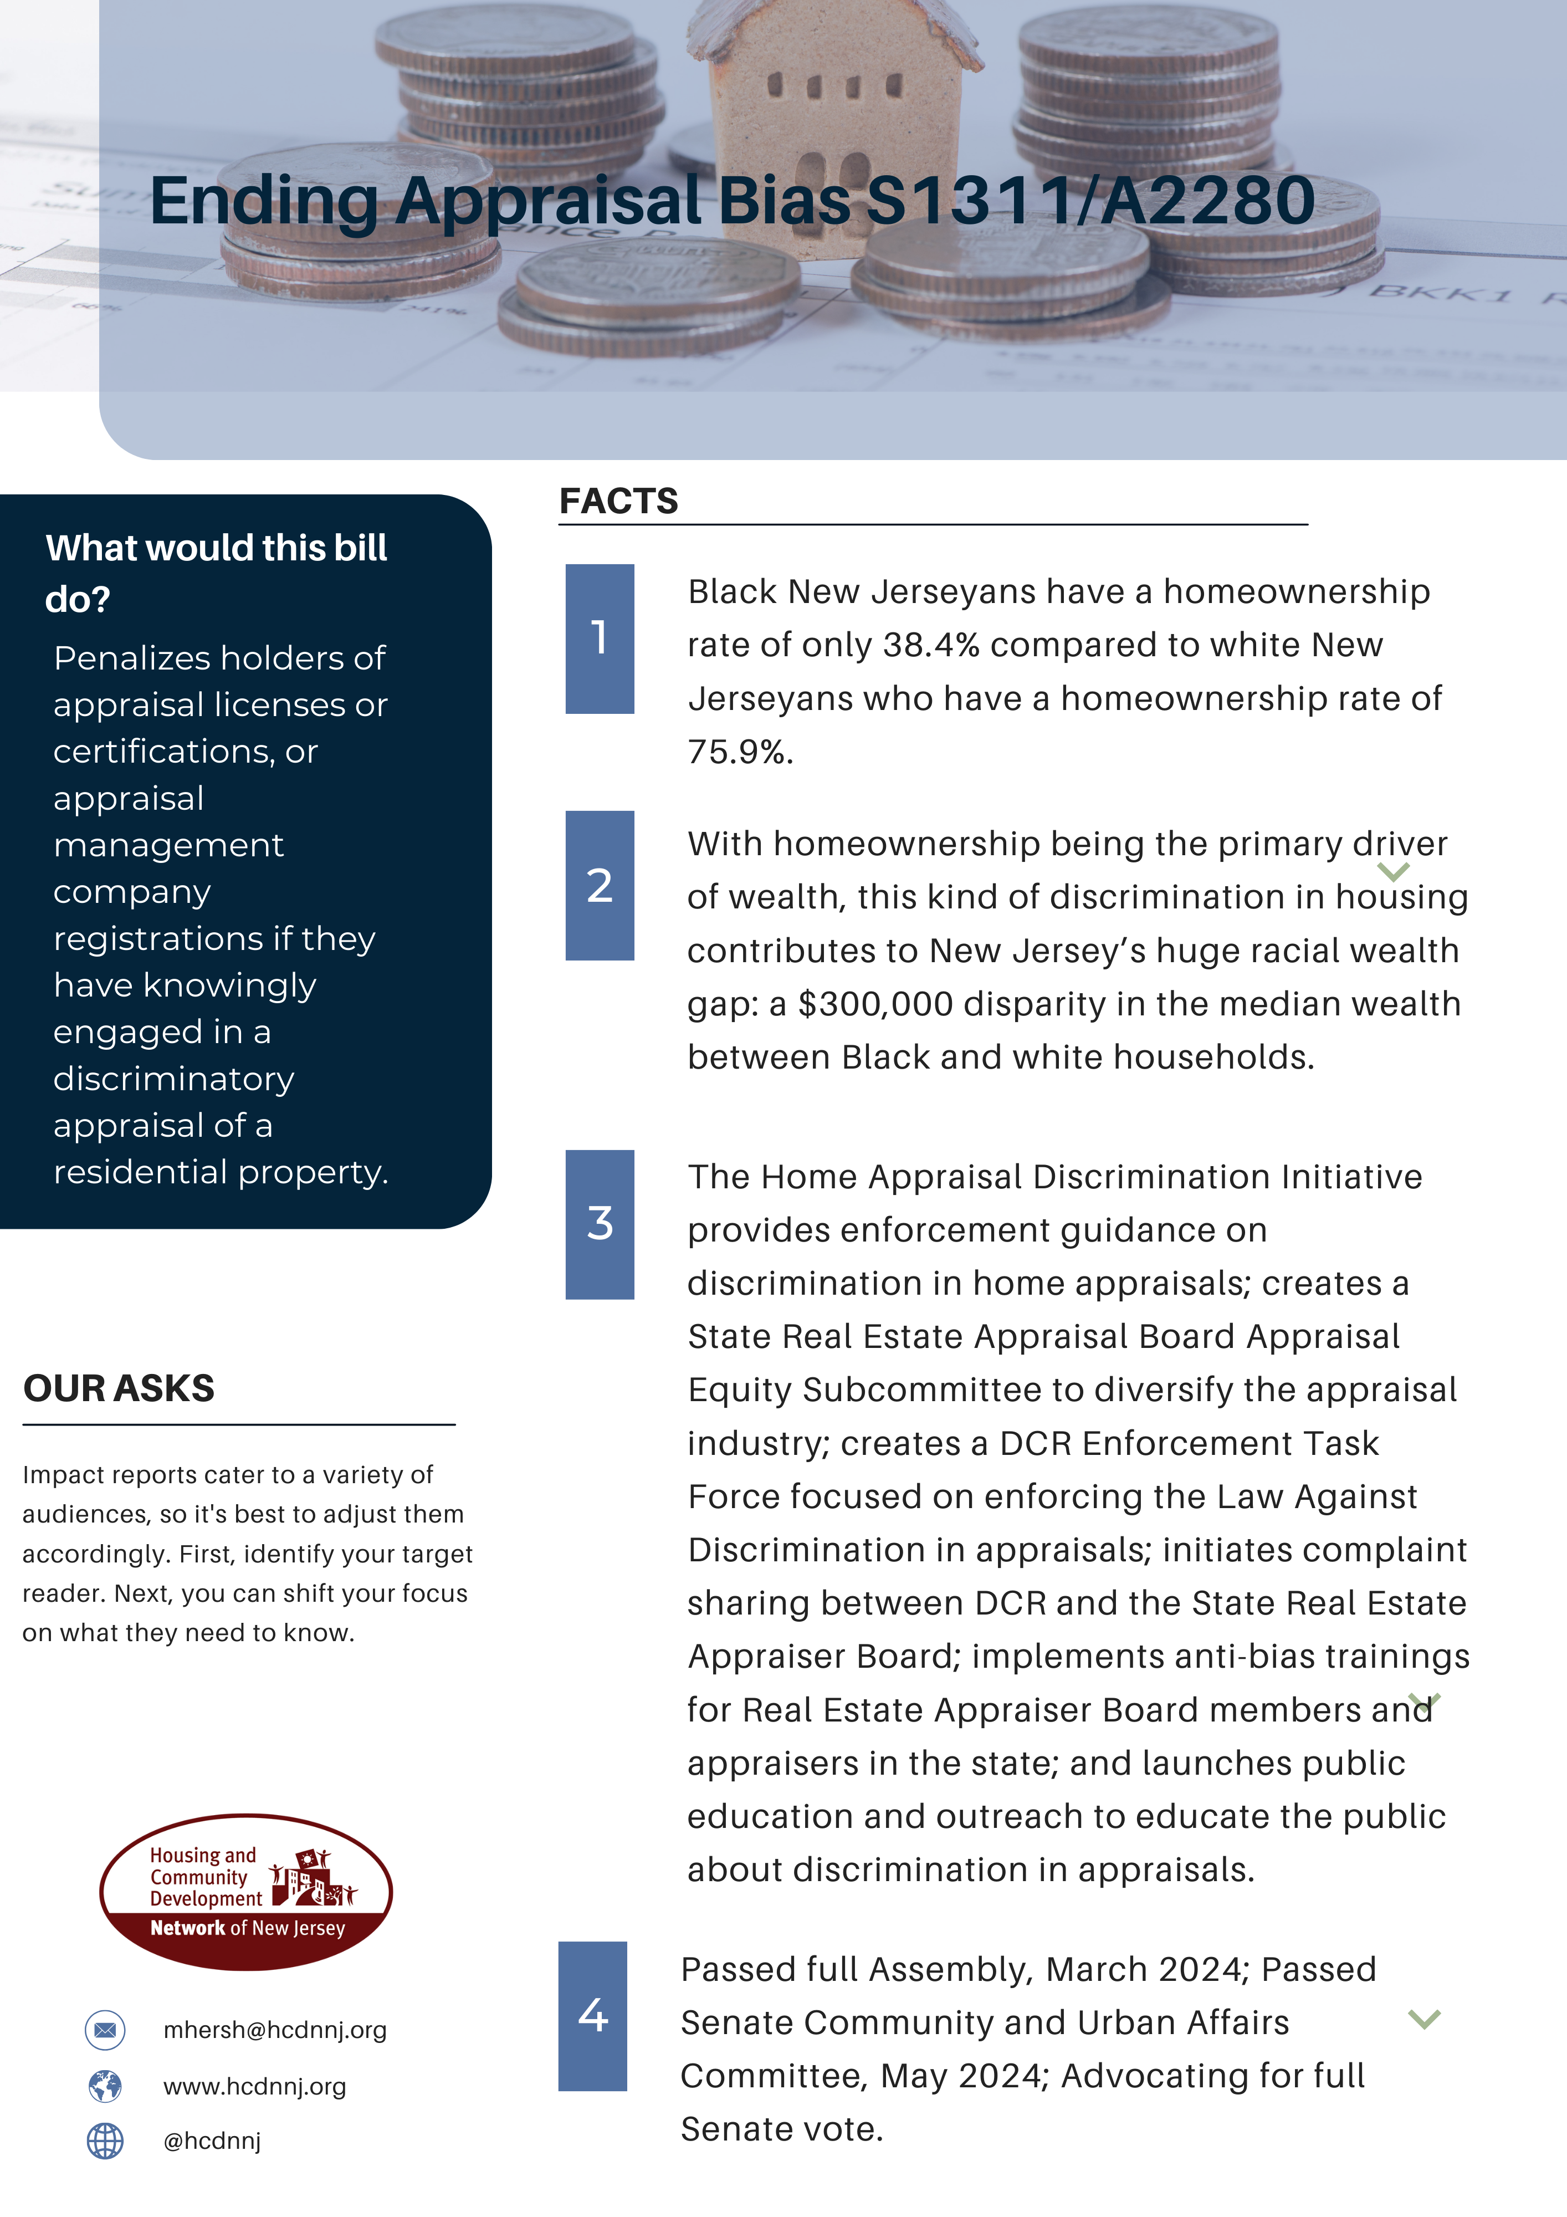
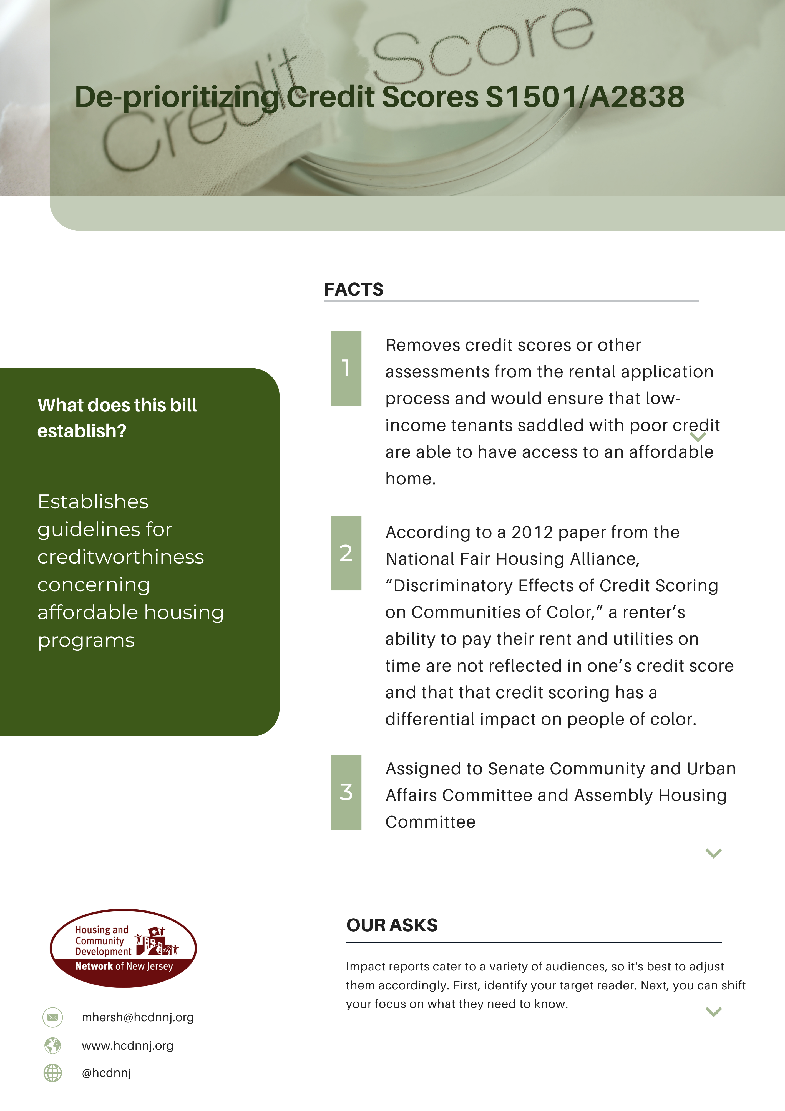
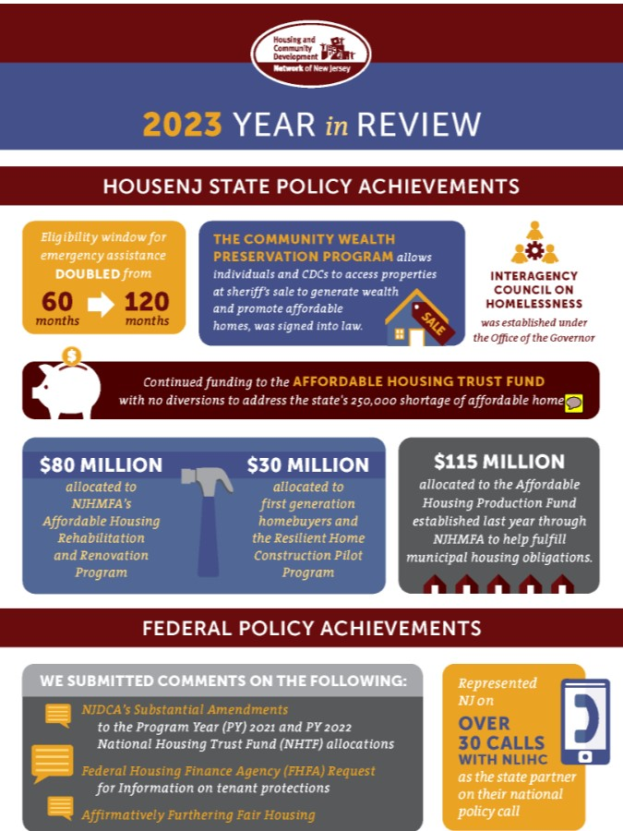
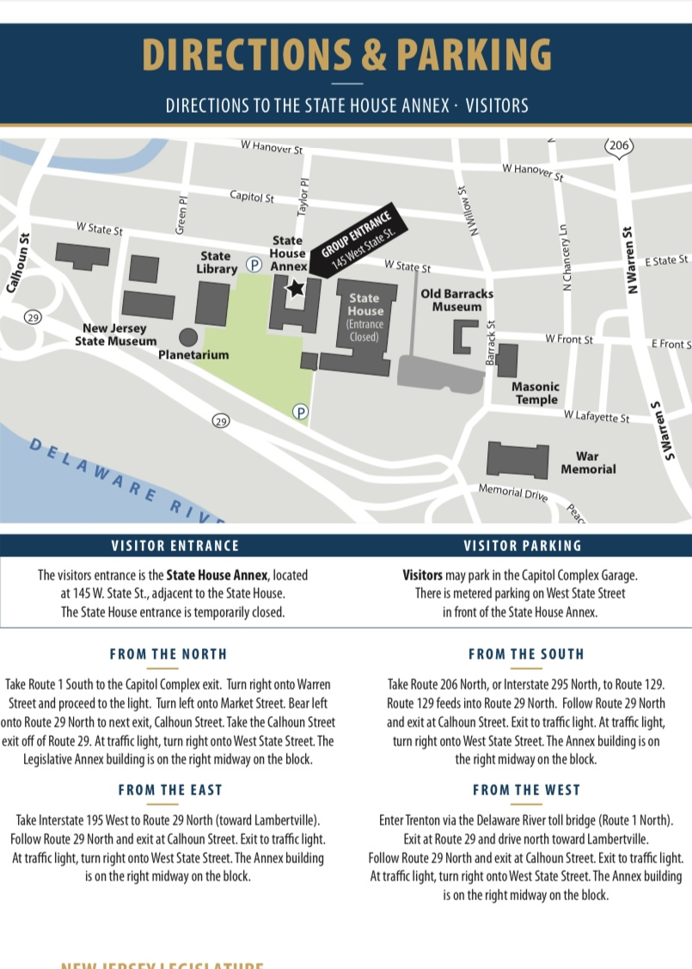

Legislative Day 2024 – Advocacy Materials
2024-2025 Policy Priorities
Primers on Code Red, Appraisal Bias, and Creditworthiness
NRTC Toolkit
Affordable Housing Trust Fund Primer
2023 Year in Review
Legislative Advocacy Do’s and Don’ts
Legislator Directory
State House Map

Slide 12
Legislative Day 2024: Where We’ll Be
Throughout the day, Network Staff will be located in strategic places in and around the State House, including:
Network Offices – 145 W. Hanover St.
Café NJ – State House
Assembly Children, Families and Food Security – 10 a.m., Committee Room 15, 4th Floor
Assembly Financial Institutions and Insurance – 10 a.m., Committee Room 11, 4th Floor
Assembly Housing Committee – 1 p.m., Committee Room 9, 3rd Floor
Scheduled Legislative Breakout Meetings

Slide 13

Democracy Needs You! OPRA Bill S2930/A4045
Last week, Gov. Murphy signed into law a bill that would limit Network members’ ability to access important municipal and property data, as well as thwart more investigative efforts by newspapers, activists, and more.
Network members rely on OPRA to help build strong communities using it to:
Research and address land use decisions
Gather information on Housing Trust Funds and other programs
Acquire public safety data to aid in neighborhood planning
Mobilize homelessness services and so much more
S2930/A4045 would severely decrease government transparency and our access to public records.

Slide 14

Under One Roof 2024
The Housing and Community Development Network of New Jersey's Annual Community Development Conference and Membership Meeting – Under One Roof -- is NJ's premier gathering of community development practitioners, housing advocates and private sector partners working together to make our state an even better place to live and work for all.
The conference will take place Tuesday, October 29, 2024 at the Hyatt New Brunswick

Slide 15
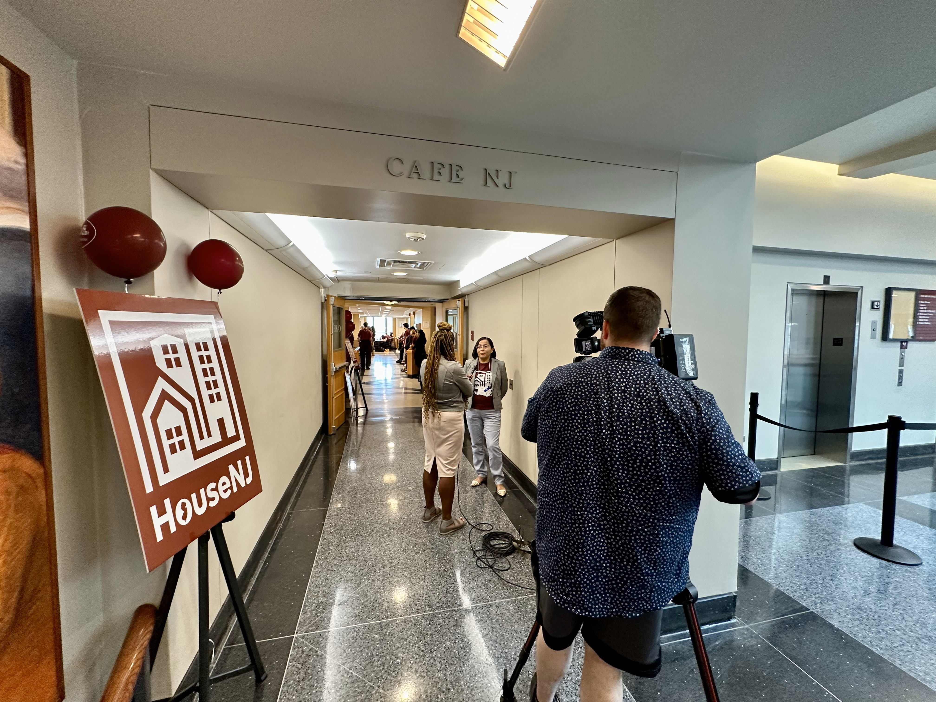
Questions?
Day of Contact:
  Matthew Hersh, mhersh@hcdnnj.org, (732) 309-3965
  Chelsea Franco, cfrancomartin@hcdnnj.org
  Cristopher Prieto, cprieto@hcdnnj.org
For a full listing of Network policy priorities, go to www.hcdnnj.org/policy-priorities
More information on Legislative Day 2024 here: https://www.hcdnnj.org/legislativeday
More on NRTC here: https://www.hcdnnj.org/nrtc

