Slide 1
Lessons Learned from ERA and What’s Next
Lindsay Duvall, Senior Housing Advocacy Organizer, NLIHC

Slide 2
ERASE Goals
Notes:
. But first, a little about NLIHC’s ERASE project. End Rental Arrears to Stop Evictions (ERASE) is a national effort that seeks to eliminate rental indebtedness caused by the pandemic and to prevent evictions by tracking and analyzing emergency rental assistance utilization; documenting and sharing best practices and toolkits; influencing and shaping program design at federal, state, local levels; developing key partnerships for outreach and education; and assessing the remaining needs to inform advocacy for long-term investments to end housing instability and homelessness in the United States.
NLIHC asked state partners, local jurisdictions and emergency rental assistance administrators to focus on three key elements to improve ERA programs– visibility, accessibility, and prevention. This included conducting equitable and robust marketing and outreach efforts to ensure that all landlords, low-income renters, and those already experiencing homelessness due to housing loss knew about the ERA program and how to access it in their community; supporting equitable access to and disbursement of financial support to landlords and tenants by ensuring an accessible, streamlined, and low-barrier ERA application process; and ensuring holistic, responsive interventions at all intersection points, such as state and local courts, to prevent evictions, housing displacement and homelessness.

Slide 3
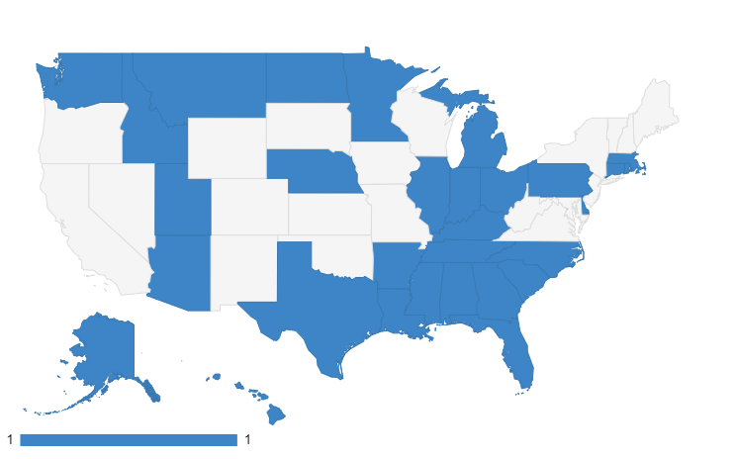
ERASE Cohort
Engage Tenants through Organizing and Story Telling
Support Transparency through Data
Implement Eviction Prevention, Diversion, and Tenant Protections
Convene State and Local Partners to Support Planning and Address Barriers
Target Marketing, Outreach, and Application Support
D.C.
Notes:
A Key element of the ERASE project is our ERASE cohort – 38 state grantees working in 30 states and DC to ensure that ERA funds reach renters and small landlords with the greatest need for assistance, especially Black, Indigenous, and people of color (BIPOC) and other marginalized people and communities and build support for long term housing solutions.
The cohort goals are to :
Influence programs to accelerate equitable distribution of emergency rental assistance funds; Advance strategies, legislation, and policy that promote tenant protections, eviction diversion and prevention; and ensure transparency and support program improvement through data collection and analysis.

Slide 4
Lessons Learned
Ensure ERAP visibility by:
Engaging trusted community-based organizations (CBOs) for outreach and marketing
Conducting outreach to landlords
Using data to target outreach and engagement
Distributing program information at critical points of intervention and directly to renters
Providing ERA outreach at eviction court
Ensure ERAP accessibility by:
Ensuring adequate staff capacity, infrastructure, and partnerships
Minimizing documentation barriers and allowing for DTA
Streamlining application processing
Providing housing navigation services to assist with applications
Improving online application systems and addressing the technological divide
Ensuring language access and providing translation services for non-English speakers
Ensuring access for people with disabilities

Slide 5
Lessons Learned
Prevent evictions via ERAP by
Pairing housing services with financial assistance to promote housing stability
Integrating ERA with landlord-tenant mediation programs
Supporting coordination between courts and ERA programs to prevent evictions
Establishing and enforcing ERA-related tenant protections at the state and local levels
Setting up eviction diversion and prevention programs

Slide 6
Components of Treasury ERA Program
Treasury ERA Program
Financial Assistance
(rent, utilities, etc.)
Housing Stability Services
Infrastructure & Partnerships
Innovation in Program policies & design

Slide 7
Eviction Crisis Act
Ask Congress to pass S. 2182
Would create a new national Emergency Assistance Fund, funded at $3 billion/yr
Covers rent arrears and up to four months of rent within a three year period
Ppl w/incomes =/< federal poverty level, < 30% AMI
Distribution based on # of ELI experiencing severe housing cost burden or overcrowding, unemployment rate, geographic diversity, etc
Also authorizes grants to support landlord-tenant community courts and a national database to track evictions

Slide 8
Long Term Housing Solutions
Explore innovative models to support tenants
Renters’ tax credit
Direct to tenant assistance
Ensure long-term affordability for the lowest-income renters
Universal vouchers
Increase the supply of affordable housing
Expand National Housing Trust Fund to $40 billion annually
$70 billion for public housing
Inclusive zoning and land use reforms
Notes:
NLIHC recommends the following actions at the state and local levels to protect tenants, prevent evictions, and support long term housing stability:
State and local governments should make permanent ERA-era tenant protections and continue to pass tenant protections in all stages of the eviction process to advance housing as a human right.
States and localities must assess their tenant-protection laws and programs to ensure maximum effectiveness in preventing evictions, from improving enforcement of source-of-income discrimination laws to adequately funding right-to-counsel programs.
ERA programs, states, and local courts should develop collaborative partnerships to ensure the successful implementation and enforcement of tenant protections at all stages of the ERA and eviction process.
State and local courts should centralize eviction filing and outcome data for facilitating access to ERA to those in need, enforce existing tenant protections, and track housing stability outcomes for tenants who may have been evicted.
Long-term federal tenant protections, such as source-of-income discrimination laws, “just cause” eviction standards, right to counsel, and sealed eviction legislation, are needed to ensure that all renters – across all jurisdictions – share a basic level of protection.

Slide 9
Tenant Protections
Short-term laws and policies
State and local eviction moratoriums
Pauses on the eviction process to allow for ERA processing
Mandates to increase information about ERA and limit tenant fees
Long-term laws and policies
Increases to tenant representation during the eviction process, such as right to counsel
Protections that reduce discrimination and promote housing stability, such as source of income discrimination and sealed/expunged eviction records legislations
Just Cause Standards
Implementing Authorities
Executive orders, court orders, ERA program policies. local ordinance, and state legislation

Slide 10
Contact
ERA Contact:
Tori Bourret
ERASE Coordinator
vbourret@nlihc.org
202-507-7463
@VictoriaBourret
Federal Advocacy Contact:
Lindsay Duvall
Senior Housing Advocacy Organizer
lduvall@nlihc.org
202-662-1530 ext 206
Notes:
Question 1
-Outreach: TV commercials (folks have satellite dishes and antennas), radio commercials, activating Americorp Vistas for door to door outreach, use of community based organizations;
-Practices that reduce burden, increase accessibility – call centers, mulitples types of applications, expanded language access, self attestation, low documentation requirements to reduce burden (relying on fact specific by proxy)
Question 2
Chickasaw Nation provides phone-based applications via their call centers. Staff record the conversations, complete applications over the phone, read self-attestation forms out loud, and accept verbal agreements from applicants as electronic voice signatures for accepting the terms and conditions of the program. Transcripts of all calls are recorded for reporting purposes. By providing an accessible application process and flexible forms of documentation, Chickasaw Nation can serve more households in need of critical assistance.
Muscogee Creek Nation set up a phone line that is automated to roll over from one call center staff to the next, until a call is answered. Outside of business hours, an automated message provides callers with answers for a few commonly asked questions and provides an email address to which applicants can send questions. Once connected, call center staff serve as case agents and help renters fill out their existing applications or submit new ones. Interviewees suggested that a responsive call center infrastructure made renters and landlords feel heard and more encouraged during the application process. –
WV- partner with WVCEH - a statewide COC – they do emergency processing in their service areas and ppl can come in person to fill out applications – supporting work of ERA program
AHFA has partnered with legal services and volunteer lawyers in rural communities specifically and the balance of state COC- The COC and legal groups Have better relationships and skills in dealing with LLs in rural communities. And If tenants have a lawyer, they are more likely to show up b/c they know what they need to do, where to go, etc. Travel is difficult, but when there is more incentive, makes it worth it

