Slide 1
October 2022
Housing and Community Development Network of New Jersey: Under One Roof
Michael Neal, Principal Research Associate Housing Finance Policy Center
Notes:
Alanna McCargo
Introduce HFPC
Happy homeownership month and thanks for all you are doing to support creating new homeowners every day.

Slide 2
Rates Have Begun to Rise, Worsening Affordability
Sources: Freddie Mac and US Treasury Department and Author’s calculations.

Slide 3
Home Prices Have Risen, Worsening Affordability
Sources: : Black Knight Home Price Index Data and the National Association of Realtors.

Slide 4
Mortgage Applications and Key For-sale Activity are Lower
Sources: Mortgage Bankers Association, CoreLogic MarketTrends, National Association of Realtors, Census Bureau and US Department of Housing and Urban Development.

Slide 5
Mortgage Characteristics Based on Sales Price Increase
 | 2020 Characteristics | Estimated Sales Price Increase | Percentage Change
Median property value | $355,000 | $413,950 | 17%
Loan-to-value ratio | 91.5% | 91.5% | 0%
Principal Loan Amount | $325,000 | $378,968 | 17%
Loan term in months | 360 | 360 | 0%
Median mortgage rate | 3.25% | 3.25% | 0%
Monthly mortgage payment | $1,414.42 | $1,649.29 | 17%
First payment (principal) | $534.21 | $622.92 | 17%
First payment (interest) | $880.21 | $1,026.37 | 17%
Total principal paid | $325,000 | $378,969 | 17%
Total interest paid | $184,191.39 | $214,777.37 | 17%

Slide 6
Mortgage Characteristics Based on Mortgage Rate Increase
 | 2020 Characteristics | Estimated Mortgage Rate Increase | Percentage Change
Median property value | $355,000.00 | $355,000.00 | 0%
Loan-to-value ratio | 91.50% | 91.50% | 0%
Principal loan amount | $325,000.00 | $325,000.00 | 0%
Loan term in months | 360 | 360 | 0%
Median mortgage rate | 3.25% | 5.50% | 69%
Monthly mortgage payment | $1,414.42 | $1,845.31 | 30%
First payment (principal) | $534.21 | $355.73 | -33%
First payment (interest) | $880.21 | $1,489.58 | 69%
Total principal paid | $325,000.00 | $325,000.00 | 0%
Total interest paid | $184,191.39 | $339,313.13 | 84%

Slide 7
Cumulative Interest and Principal Payments over a 30-Year Fixed-Rate Mortgage

Slide 8
Median Homebuyer Mortgage Rate in Newark by Race and Ethnicity
 | White | Black | Hispanic
2019 | 4.13% | 4.25% | 4.25%
2020 | 3.13% | 3.25% | 3.25%

Slide 9
Average Home Equity Remains Elevated
Sources: Author’s calculations and Federal Reserve Board, CoreLogic MarketTrends.

Slide 10
Home Equity Lines of Credit – Bank Supply and Demand
Sources: Author’s calculations and Federal Reserve Board.

Slide 11
Immediate Demand Response to Higher Mortgage Rates
Sources: Mortgage Bankers Association

Slide 12
Demographics Point to Strong Potential Demand
Sources: Author’s calculations based on data from the Census Bureau and Pew Research.

Slide 13
Demographics Point to Strong Potential Demand
Sources: Author’s calculations based on data from the Census Bureau and Pew Research.

Slide 15
New Housing Supply
United States
New Jersey

Slide 16
Nationwide: Absent Policy Change, Racial and Ethnic Homeownership Rate Gaps Will Remain Wide
Sources: Decennial censuses, American Community Surveys, and Urban Institute projections.
Notes: Values for 2020 and 2040 are projected values.

Slide 17
New Jersey Homeownership Gaps
Sources: Decennial censuses, American Community Surveys, and Urban Institute projections.
Notes: Values for 2020 and 2040 are projected values.

Slide 18
What Steps Can Local Policymakers Take to Offset Worsening Affordability and Slower Up-Front Equity Accumulation?
Down payment assistance along with interest rate paydowns can help
Broader income support can lower the mortgage cost burden
Expanded subsidies to boost more affordable housing supply can limit property valuations
Property taxes and insurance, as well as the propensity to refinance, also pay a critical role in determining monthly payment amounts
Housing market conditions are widely expected to be challenging over the coming year.

Slide 19
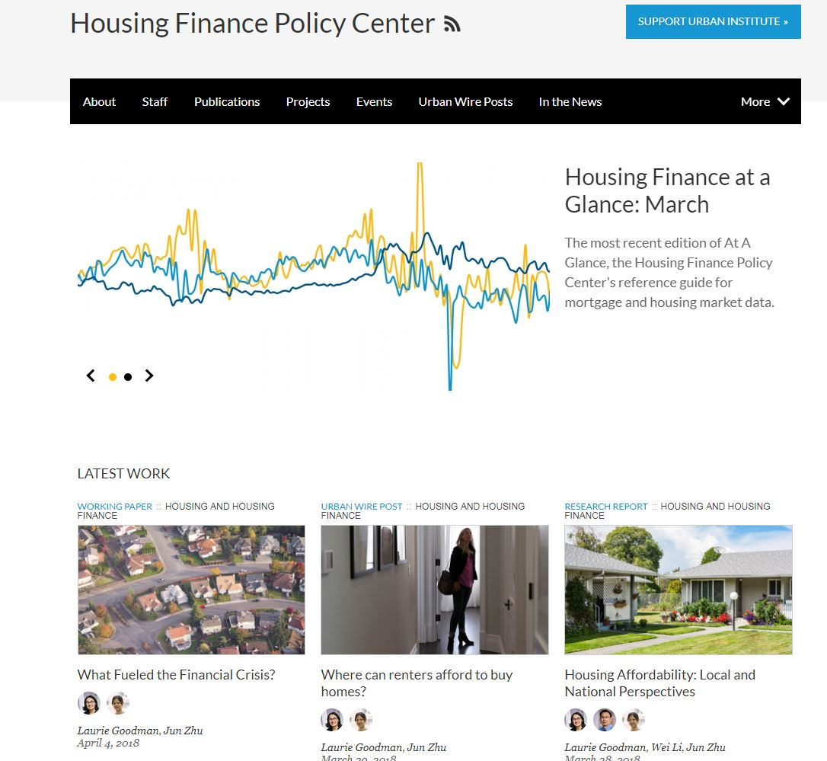
Stay connected to our research
Subscribe to our bi-monthly Newsletter or email blast: Email dneeleybertrand@urban.org or go to our web page, scroll down and sign-up.
Download our monthly Housing Finance At-A-Glance Chartbooks
Contact us by e-mail: mneal@urban.org
Check the Housing Finance Policy Center website regularly: www.urban.org/center/hfpc

