Slide 1
( A DIVISION OF
NEWARK LAND BANK
INVEST NEWARK)
Marc us Randol ph, Pre s i de nt & CEO
Roy Southerland, Chief Investment Officer
Mar t ha B aez, S VP Land B ank Operat i ons

Slide 2
THE PRIORITIES
Boost Reduce Create Increase Expand Increase Support Improve
Boost Homeownership
Reduce blight
Create affordable and market rate housing
Increase MWBE developer or subcontractor capacity
Expand neighborhood business opportunities
Increase property values
Support community goals
Improve the quality of life for Newark residents

Slide 3
THE OPPORTUNITIES
EQUITABLE HOMEOWNERSHIP
PRO Newark – Qualified buyers seeking to purchase their first home can make an immediate offer to purchase, renovate and occupy land bank property.
Move-In Ready – Land bank will offer homes for sale that have already been fully renovated by local M/W/DBE contractors.
Resident Advantage - Allows only applicants that are existing Newark residents to
purchase a PRO Newark or Move-In Ready property.
Section 8 – Qualified Section 8 recipients may use their vouchers and down payment assistance to purchase single family homes.
SIDE LOT INITIATIVE
Vacant lots sold to contiguous property owners for nominal consideration in order to increase their yard space, install a driveway, or add an addition to their home, where permissible.

Slide 4
THE OPPORTUNITIES
REQUEST FOR PROPOSAL (RFP)
Competitive sales to the highest qualified bidder that demonstrates the ability to timely renovate or develop.
ECONOMIC DEVELOPMENT
Sale of property for the purpose of larger scale development consisting of new construction, residential repurposing, mixed-use, commercial, industrial or manufacturing projects.
NEIGHBORHOOD BUSINESS EXPANSION
Real estate development and revitalization projects targeting business expansion along Newark’s
traditional commercial corridors
NONPROFIT COMMUNITY PARTNERSHIP
Sale of property to non-profit community partners that are furthering the City’s plans, goals and initiatives
for building sustainable neighborhoods, and who are providing impactful wraparound services.

Slide 5
THE PROCESS
90 Days to Close
START: GO TO THE NEWARK LAND BANK WEBSITE
REVIEW: Website and familiarize yourself with sale policies, procedures and available properties
REGISTER: Create an account to purchase property and stay engaged
STEP 1: APPLICATION PHASE (21 DAYS)
APPLY: Complete and submit application - $50 Non-refundable fee ($150 for Developers)
QUALIFY: A background check is performed, and application information is verified
INSPECT: Qualified applicants must inspect the property before submitting a formal offer
STEP 2: BID SUBMISSION / ACCEPTANCE PHASE (40 DAYS)
OFFER: Must be submitted online with scope of work and verifiable financing
CONTRACT: If your offer is selected, you will be provided with a purchase agreement
DEPOSIT: An earnest money deposit must be returned with the signed purchase agreement by a date certain
STEP 3: CLOSING PHASE (30 DAYS)
CLOSE: NLB drafts a Quit Claim Deed and arranges closing
Sales must close within 90 days from the offer acceptance date
Unsubstantiated delays subject to sale cancellation and deposit forfeiture
Application Phase
(21 days)
Bid Submission Phase
(40 days)
Closing Phase (30 days)
5

Slide 6
RESIDENT APPLICANT CHECKLIST
Application Fee ($50 for Resident Advantage & PRO Newark)
Completed Application
Licensed Contractor Info
Proposed Scope of Work / Budget
Proof of Funds / Mortgage Pre-Approval

Slide 7
DEVELOPER APPLICANT CHECKLIST
Application Fee ($150 for Vacant Lots)
Completed Application
Executive Summary (For Vacant Lots / Developers)
Development Proposal
Financial Capacity for Project
Experience History
Copy of Applicant’s New Jersey Business Registration
Certificate
Copy of Applicant’s Certificate of Formation
Copy of Applicant’s Articles of Incorporation or
Articles of Organization
Two (2) professional references
List of all members, partners, and shareholders

Slide 8
THE RULES
Potential Buyers will be:
Individuals/families demonstrating the ability to purchase, rehabilitate, and occupy homes for
a given period of time.
For Newark residents only under the “Resident Advantage” Sale process
Experienced and qualified developers, partnerships or investors committed to equitable economic growth and efficient development
Businesses that will own and occupy commercial properties
Qualified nonprofit community partners
Potential Buyers cannot have:
Un-remediated code violations
Delinquent tax payments to the City of Newark
Properties that were transferred to local government as a result of In-rem foreclosure
Stalled development projects
8

Slide 9
THE RULES (continued…)
Applications and Purchase Agreements require a fee and earnest money deposit, respectively
Not more than 10 properties conveyed in a single transaction, subject to the specific terms and conditions set forth in a specific Program or RFP
NLB arranges for closings to take place no later than ninety (90) days from the offer acceptance date
Deeds will be held in escrow and/or deed restrictions will be imposed to ensure buyers uphold commitment to application & purchase agreement terms
NLB will reserve right to repossess (revert) non-compliant and stalled projects
Entire inventory of all real property held by NLB will be made available on the website at
www.investnewark.org/land-bank

Slide 10
THE CHECKS & BALANCES
Invest Newark Staff will administer land bank operations; including acquisition and disposition programs.
Invest Newark Board of Directors consisting of public & private civic leaders, economic and real estate development professionals will provide oversight to the land bank.
The Land Bank will report KPIs to Newark City Council at least quarterly.
The Land Bank has a Community Advisory Board consisting of recognized businesses, community associations, and nonprofit organizations to provide valued input into land bank programs on an ongoing basis.

Slide 11
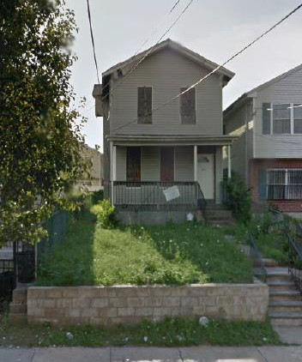
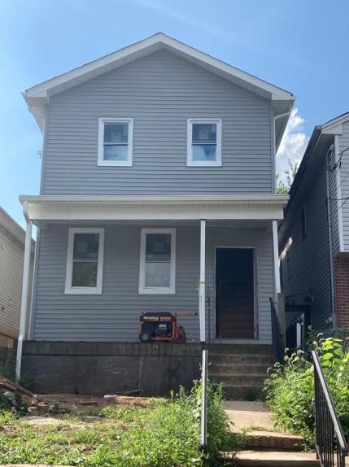
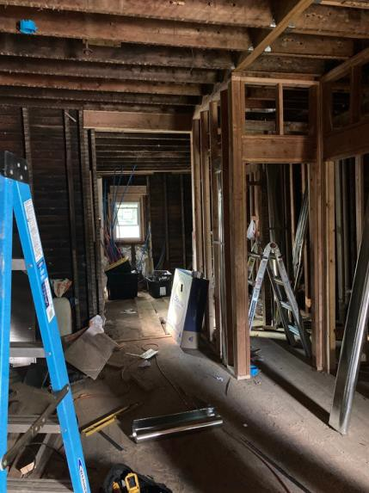
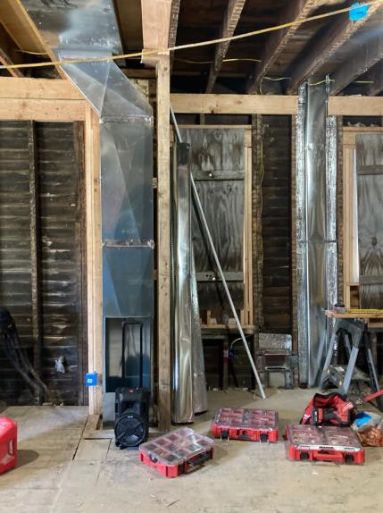
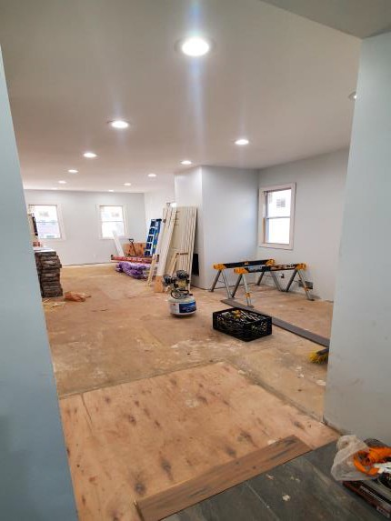
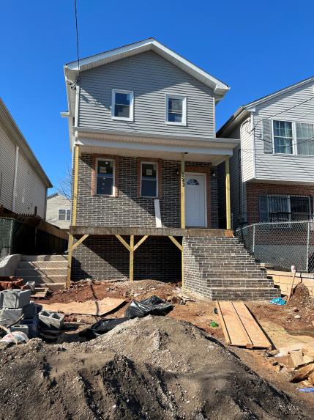
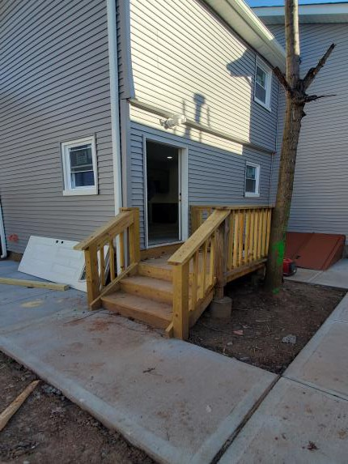
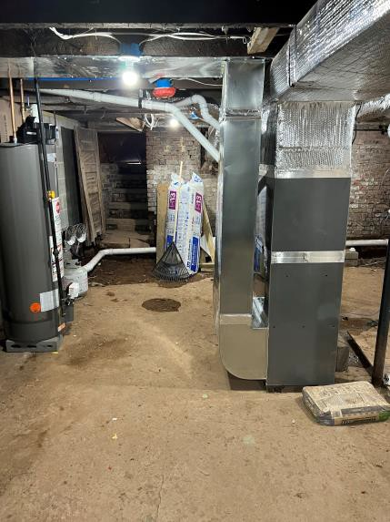
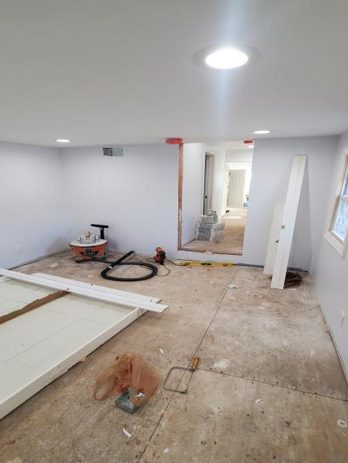
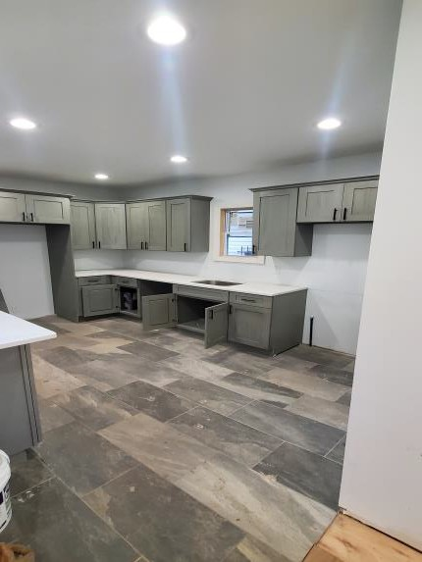
SECTION 8 - 223 PESHINE AVENUE

Slide 12
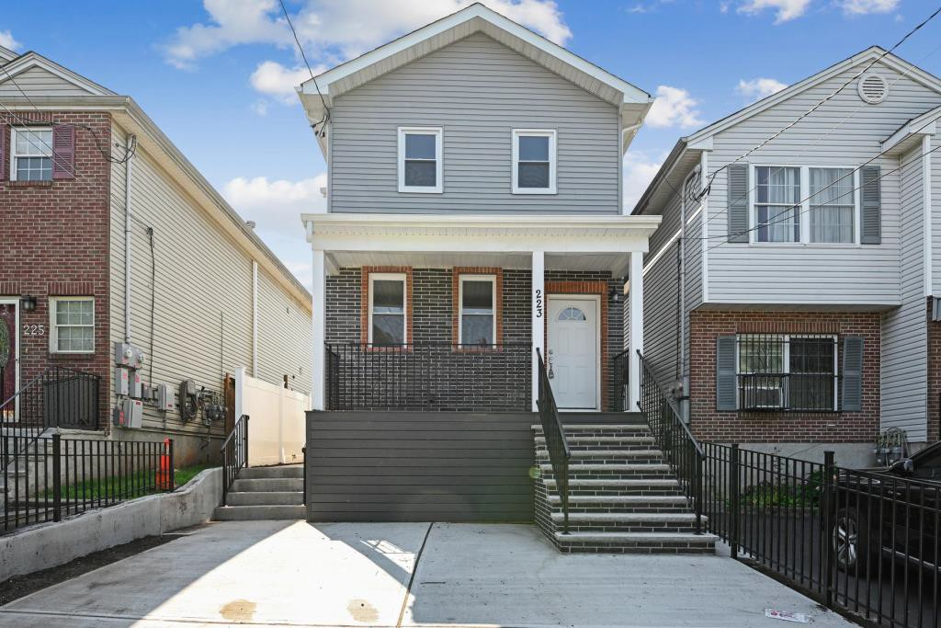
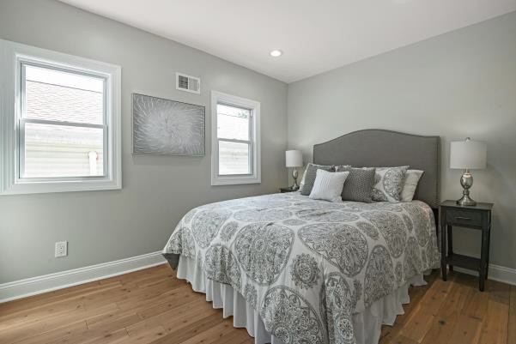
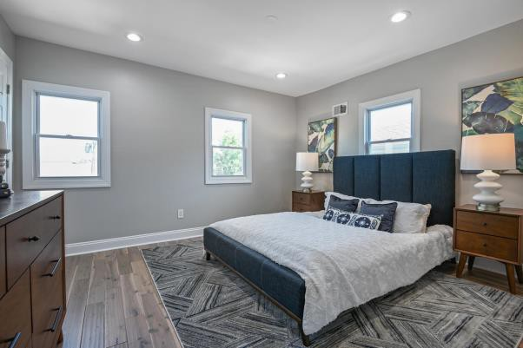
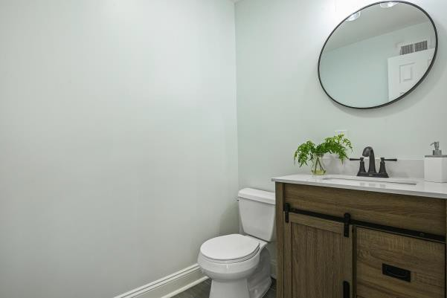
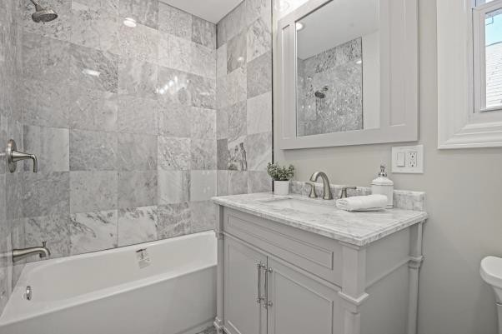
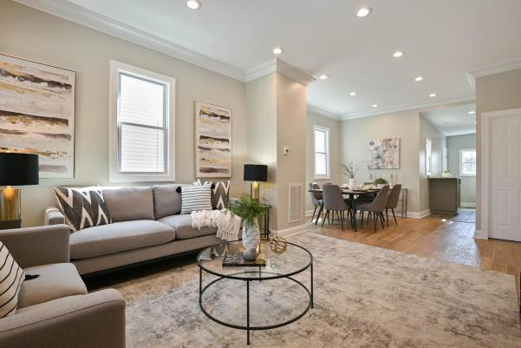
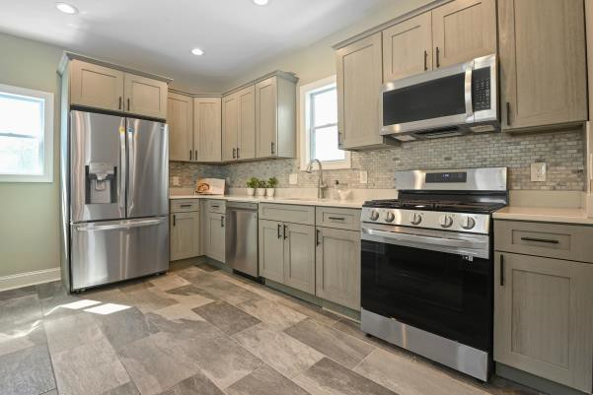
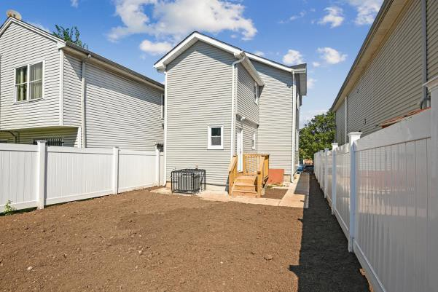
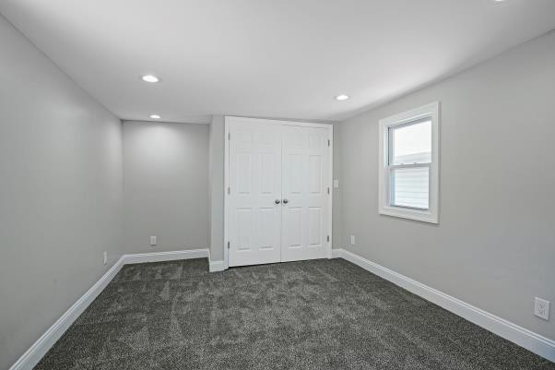
SECTION 8 - 223 PESHINE AVENUE

Slide 13
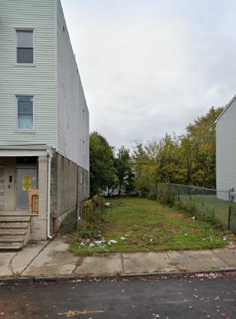
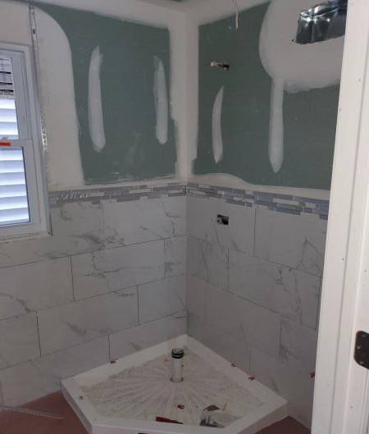
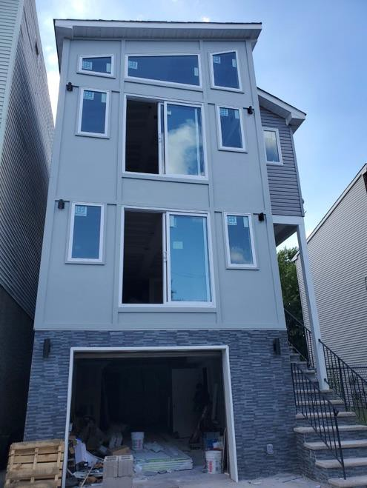
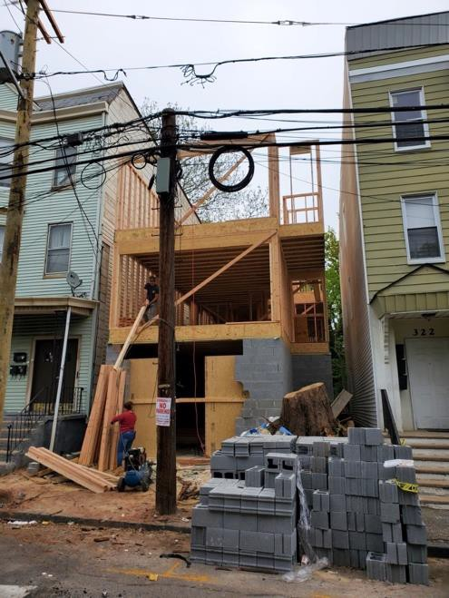
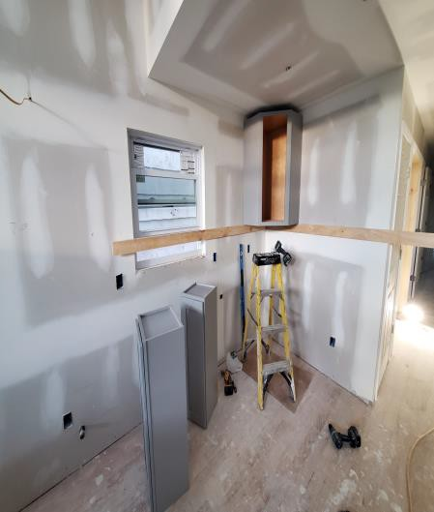
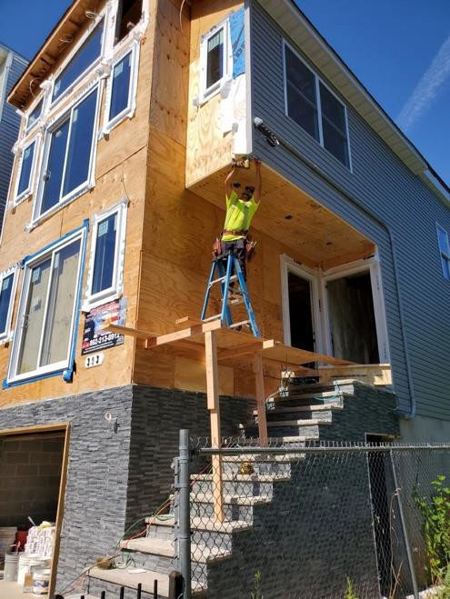
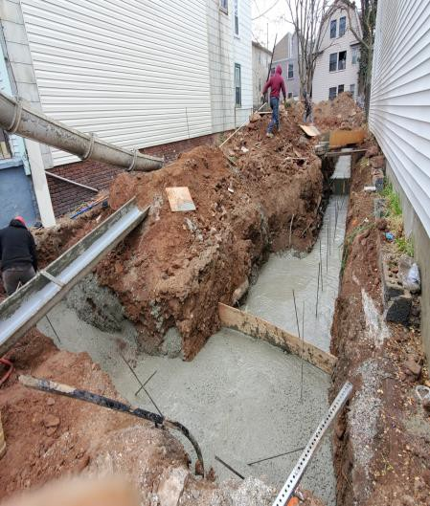
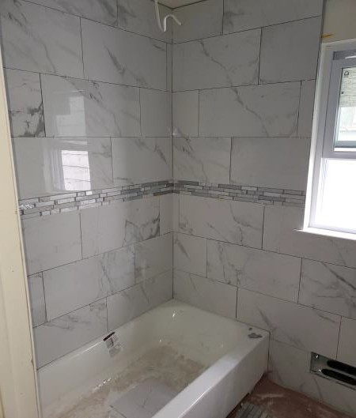
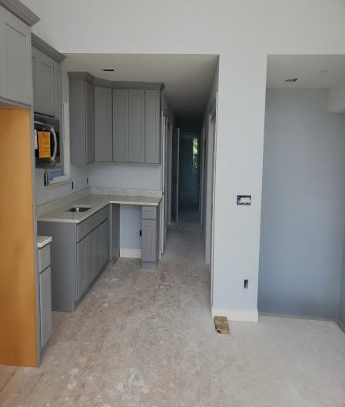
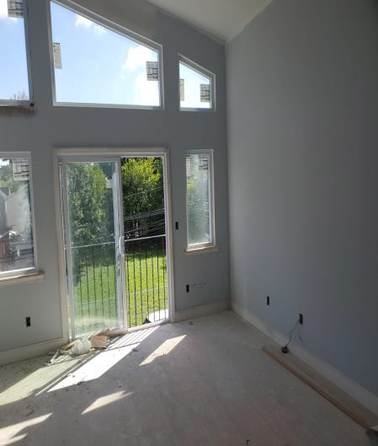
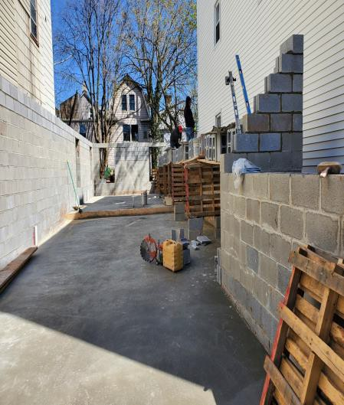
VACANT LOT- 320 S 7TH STREET

Slide 14
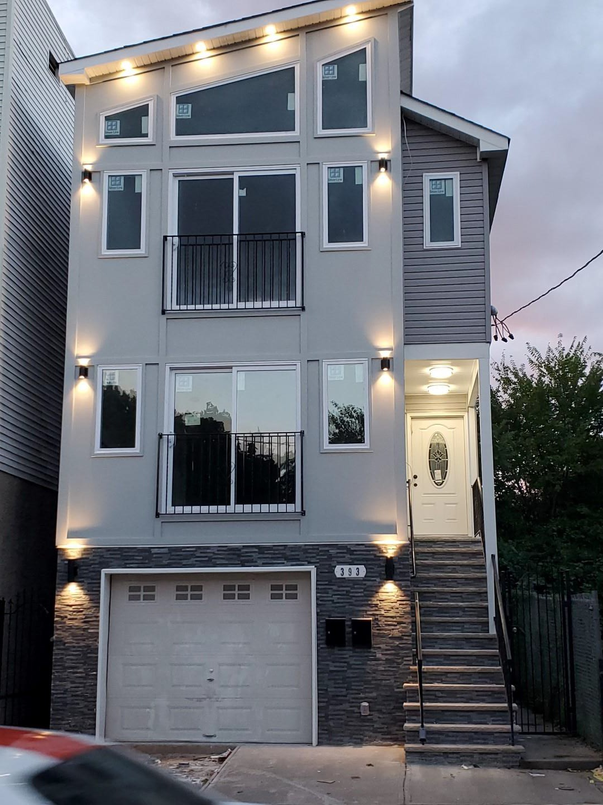
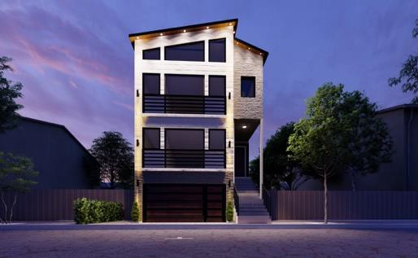
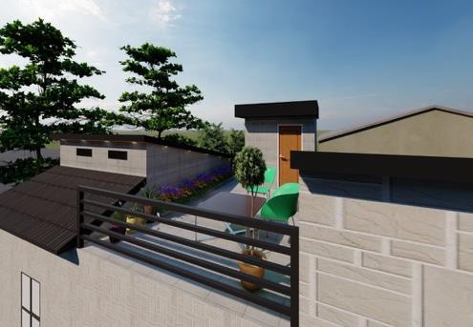
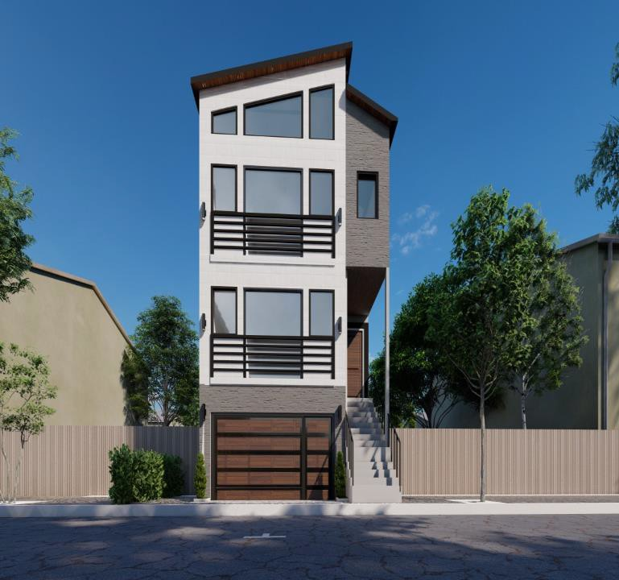
VACANT LOT- 320 S 7TH STREET
Program: Vacant Lot Buyer/Developer: Harsh Realty Sold: September 22, 2021
Lot Size: 25 X 100
Construction time:
12 months
Construction Type:
2-family home
Features: 3 bedrooms, 2 baths, finished basement, Roof deck

Slide 15
THE WEBSITE
LISTS CURRENT & FORMER PROPERTY INVENTORY
POLICIES AND APPLICATIONS
RECORD OF ACQUISITION & DISPOSITION ACTIVITIES
HOW-TO TUTORIALS
STRATEGIC PLAN AND FISCAL REPORTS (PUBLISHED ANNUALLY)
15

Slide 16
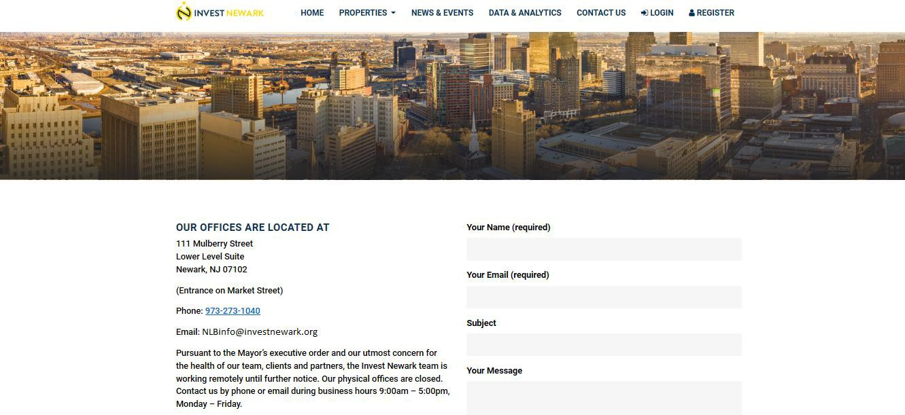
Questions?
Contact Us at NLBinfo@investnewark.org

