Slide 1
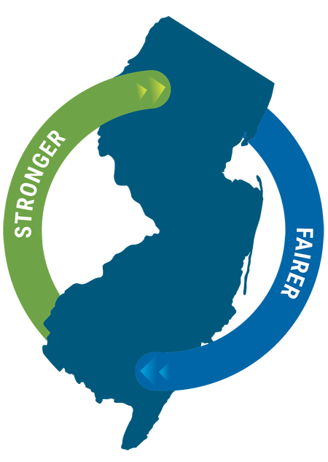
NJ Economic Development Authority (NJEDA) - State Resources
Presented by:
Christina Fuentes
VP, Community and Business Development
October 21, 2022

Slide 2
About the NJEDA
The New Jersey Economic Development Authority (NJEDA) serves as the State’s principal agency for driving economic growth. The NJEDA is committed to making New Jersey a national model for inclusive and sustainable economic development by focusing on key strategies to help build strong and dynamic communities, create good jobs for New Jersey residents, and provide pathways to a stronger and fairer economy. Through partnerships with a diverse range of stakeholders, the NJEDA creates and implements initiatives to enhance the economic vitality and quality of life in the State and strengthen New Jersey’s long-term economic competitiveness.
HELPING TO BUILD A STRONGER AND FAIRER
NEW JERSEY ECONOMY
Notes:
The NJEDA is New Jersey’s principal agency focused on driving economic growth in alignment with Governor Phil Murphy’s vision for a stronger, fairer New Jersey.
The NJEDA grows the state’s economy and increases equitable access to opportunity by supporting high-quality job creation, catalyzing investment, and fostering vibrant, inclusive community development.
To achieve these goals, we work in partnership with a diverse range of stakeholders to implement programs and initiatives that improve quality of life, enhance economic vitality, and strengthen New Jersey’s long-term economic competitiveness.

Slide 3
New Jersey Economic Recovery Act of 2020 (ERA)
The ERA also includes language to make incentives more accessible to small businesses, encourages further investments in innovation, provides $350 million in tax credits for offshore wind projects, and increases state subsidies for Brownfield Tax Credits.
The ERA is both a broad-based recovery bill and reform bill that will better position New Jersey to recover from economic crisis caused by the COVID-19 pandemic, while remaining true to the NJEDA’s commitments to transparency and accountability.
Governor Phil Murphy signed the New Jersey Economic Recovery Act of 2020 (ERA) into law on January 7, 2021. The ERA creates a package of tax incentive, financing, and grant programs that will build a stronger, fairer New Jersey economy.
Visit the NJEDA’s website at www.njeda.com/economicrecoveryact to learn more about each of the programs within the ERA, or to provide general ERA feedback.

Slide 4
New Jersey’s Economic Priorities
1
Investing in people
to help all New Jersey residents find meaningful work
2
Investing in communities
to build world-class cities, towns, and infrastructure
3
Making New Jersey the State of Innovation
to create more and better jobs across the state
4
Making government work better
to improve New Jersey’s competitiveness and business climate

Slide 5
New Programs Supporting these Strategies
1
Emerge Program
5
Food Desert Relief Program
(Under Construction)
Main Street Recovery Program
2
NJ Aspire Program
6
(Under Construction)
3
Historic Property Reinvestment Program
Brownfield Redevelopment Incentive
7
(October Board)
NJ Innovation Evergreen Fund
Community-Anchored Development Program
4
8
(Under Construction)

Slide 6
1
Emerge Program
Job based tax credit focused on communities with the greatest levels of distress
Targets Governor’s priority sectors for economic growth
Focus on new jobs with minimum job creation targets for most projects
Business must make minimum capital investment in eligible area
Can meet requirement with donations to a local infrastructure fund
Net benefit requirement of 200% – 400% of award amount
Retention projects limited to those retaining more than 500 jobs
Capped with NJ Aspire at $1.1B per year over 6 years
$1.1B cap covers both programs

Slide 7
3
Historic Property Reinvestment Program
Typically one-time tax credit issued in the year of completion of redevelopment
Annual Appropriation: $50M
Project Award: 40 up to 45% of remediation costs
Award Cap: $4 million to $8 million
Building be listed on the National Register of Historic Places OR approved by the State Historic Preservation Officer
Limited to income producing projects
Program allows for development period flexibility
Competitive application process
Leverages National Historic Tax Credit

Slide 8
4
NJ Innovation Evergreen Fund (NJIEF)
$500M+ venture investment fund for New Jersey companies
50% public money (auction of $60M of tax credits per year for 5 years)
50% private money via matching investments
Qualified venture firms can draw up to $5M for two investments per year in NJ-based companies in the State’s focus sectors
Increased individual investment cap for ventures utilizing NJ-based college IP or that are certified woman or minority owned
Goal of 25% of fund invested in communities in distress
As exits are realized, the proceeds will be distributed back to NJIEF, providing self-sustaining streams of funds

Slide 9
MAIN STREET RECOVERY PROGRAM

Slide 10
MAIN STREET RECOVERY PROGRAM
MAIN STREET RECOVERY PROGRAM
$150 MILLION
Appropriated for several products to support New Jersey small businesses. Products are expected to consist of:
GRANTS TO SMALL BUSINESES
GRANTS TO SMALL BUSINESSES
Will support NJ small businesses (as defined by SBA) with renovations, improvements, lease payments, and purchase and/or installation of furnitre, fixtures and equipment.
LOANS TO MICRO BUSINESSES
Low-cost financing will support NJ micro businesses, defined as businesses with 10 or fewer full-time employees, and less than $1.5M in annual revenue.
RESOURCES FOR LENDERS
CDFIS, MDIS, ZONE DEVELOPMENT CORPS, COMMUNITY & ECON DEVELOPMENT CORPS
RESOURCES FOR LENDERS
LOANS TO MICRO BUSINESSES
Loans and grants to lenders that have at least 10 years of experience servicing micro businesses. These resources will help lenders support more micro businesses with loans and technical assistance.

Slide 11
INITIAL PRODUCT OFFERINGS
The Main Street rule proposal establishes two initial product offerings:
SMALL BUSINESS LEASE GRANT
SMALL BUSINESS IMPROVEMENT GRANT
Provides grant funding to offset a portion of lease payments for businesses leasing new or additional space. Program launched 10/20/21
Reimburses business owners for costs associated with making interior or exterior building improvements, or purchasing/installing furniture, fixtures, or equipment. Launched 2/10/22

Slide 12
OPPORTUNITY ZONES
40% of grant funding will be set aside for businesses located in opportunity zone eligible census tracts.
OFFSET LEASE PAYMENTS
Provides grants to businesses to offset a portion of annual lease payments for leases with a minimum 5-year term. Leases must have been executed within 12 months of application to be eligible.
SMALL BUSINESS
LEASE GRANT
$10 MILLION
TWO PAYMENT DISBURSEMENTS
Grant payments are made in 2 disbursements: first disbursement will be made after execution of grant agreement (20% of annual lease payment), and the second disbursement will be made after 12 months of lease payments by the applicant (20% again).
MULTIPLE LOCATIONS
Applicants with multiple locations are limited to one application per location.
$100 APPROVAL FEE
Due at time of approval & prior to the execution of the grant agreement.

Slide 13
OPPORTUNITY ZONES
40% of grant funding will be set aside for businesses located in opportunity zone eligible census tracts.
GRANT FUNDING FOR PROJECTS
Provides grant funding equal to 50% of project costs (max $50,000) for the reimbursement of: interior and exterior renovations, purchase and installation of new furniture, fixtures, and equipment. Minimum project cost of $5,000.
SMALL BUSINESS
IMPROVEMENT GRANT
$15 MILLION
MULTIPLE LOCATIONS
Entities operating in multiple locations under a single EIN are limited to one application under the sole EIN, but a single application may include costs across multiple locations.
EMPLOYER IDENTIFICATION NUMBER
Limit of one grant per Employer Identification Number (EIN).
APPROVAL FEE
$100 due at time of approval and prior to the execution of the grant agreement.

Slide 14
MAIN STREET RECOVERY FUND
REQUIREMENTS
Main Street grant applicants must be prepared to comply with the following requirements:
Wage Requirements - Employees must be paid the greater of $15/hour or 120% of minimum wage on all full time and part time employees.
NJEDA will monitor for this annually, by collecting either a WR-30, payroll report, or equivalent documentation.
Commitments under each grant, subject to businesses repaying the grant for non-compliance:
Small Business Lease Grant – Must commit to remaining in the facility and meeting the wage requirements for 5 years after signing grant agreement.
Small Business Improvement Grant:
For grants of less than $25,000, business must commit to remaining in the facility and meeting the wage requirements for 2 years following grant agreement.
For grants of $25,000 or more, business must commit to remaining in the facility and meeting the wage requirements for 4 years following grant agreement.

Slide 15
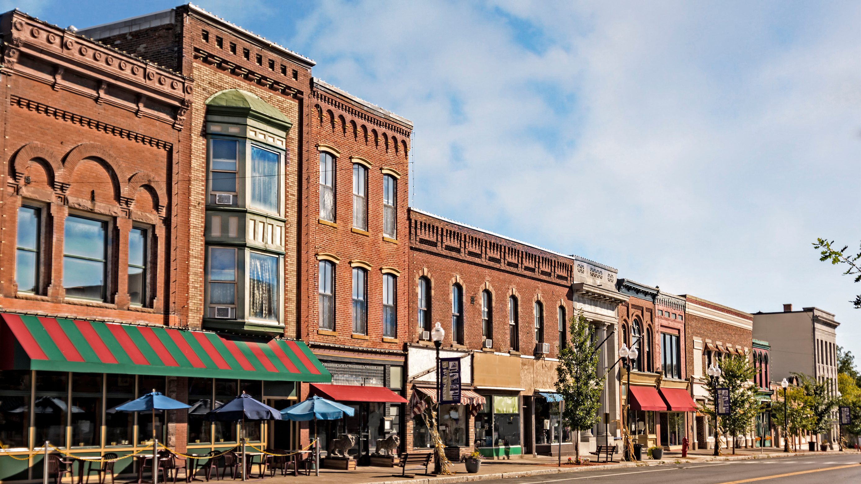
NEW JERSEY ECONOMIC DEVELOPMENT AUTHORITY
Business Banking

Slide 16
Dollar
Amount
Up To
$500,000
SMALL BUSINESS FUND
New Jersey businesses in operations for 1 year with revenue less than $3 million and reporting a profit that are in need of financing.
ELIGIBILITY
BENEFITS
Need fixed asset collateral to secure the loan.
$300 application fee, .5% commitment fee and .5% closing fee.
Must meet 1.1 (1.0 for non-profits) debt service coverage ratio.
Home-based businesses are not eligible.
Flexible interest rates.
Up to $500,000 for fixed assets (real estate or equipment).
Up to $500,000 for working capital – will still need fixed asset collateral.

Slide 17
Dollar
Amount
Up To
$2 Million
DIRECT LOANS
New Jersey businesses in operations for 2 years and reporting a profit that are in need of financing and committed to job creation/retention may be eligible for direct loans through the NJEDA when conventional financing is not available.
01
Eligibility
02
Benefits
Commit to creation or retention of one new, full-time job for every $65,000 of NJEDA exposure within two years.
Need fixed asset collateral to secure the loan.
$1,000 application fee, . 875% commitment fee and .875% closing fee.
Must meet 1.1 (1.0 for non-profits) debt service coverage ratio.
Home-based businesses are not eligible.
Flexible interest rates.
Up to $2 million for fixed assets (real estate or equipment).
Up to $750,000 for working capital – will still need fixed asset collateral.
Amortization up to 5 years for working capital and for used equipment, 10 years for new equipment transactions, and 20 years for real estate transactions.

Slide 18
PREMIER LENDER PROGRAM
Partnering with banks to ensure that New Jersey businesses and communities have the resources necessary to expand and have a healthy climate for growth.
01
Eligibility
02
Benefits
Be in operation for at least 2 full years.
Commit to creation or retention of one new, full-time job for every $65,000 of NJEDA exposure within 2 years.
1.1X Global Debt Service Coverage Ratio (for businesses);
1.0X Debt Service Coverage Ratio (for not-for-profits).
Up to 100% loan-to-value for real estate and 90% for equipment.
Home based businesses are not eligible
Access to low-cost financing that includes NJEDA loan participation and/or guarantees, and line of credit guarantees.
Financing can be used for fixed assets or term working capital.
Attractive interest rates and terms.
Dollar Amount
Up to $2 million for fixed assets
Up to $750,000 for working capital
Line of Credit Guarantees up to $750,000

Slide 19
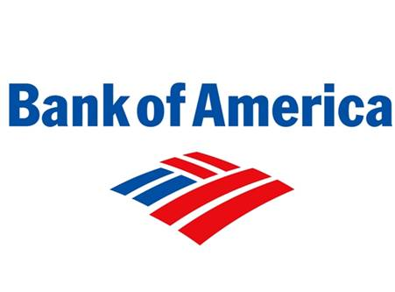
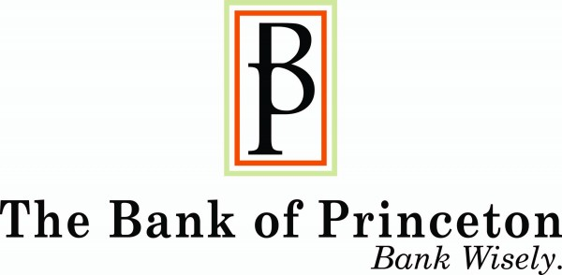
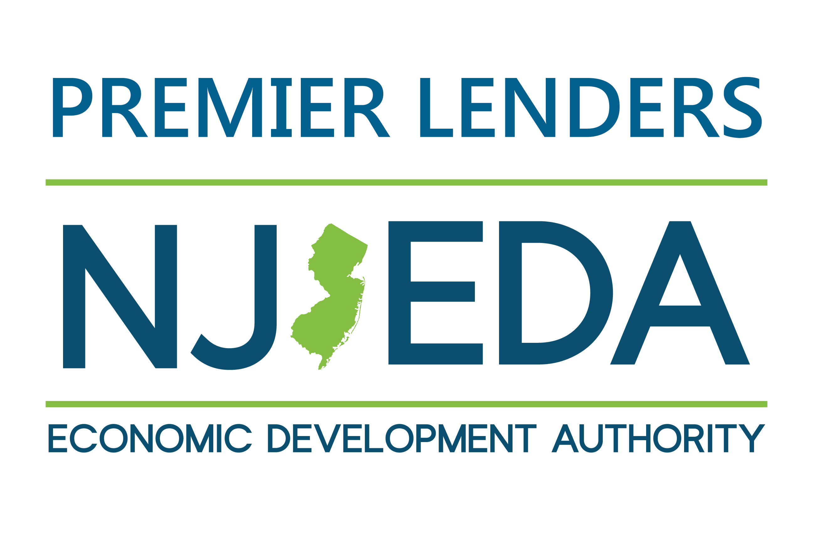
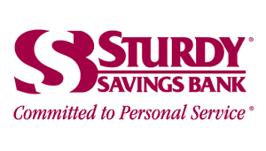
PREMIER LENDER BANKS

Slide 20
Product Details
Bond Financing
Creditworthy manufacturing companies, 501(c)(3) not-for-profit organizations, and exempt facilities in New Jersey may be eligible for long-term financing under the Bond Financing Program.
Through a federally authorized program, the EDA issues conduit tax-exempt private activity bonds, the proceeds of which are used to provide financing. Borrowers must meet the eligibility requirements outlined in the Internal Revenue Code (IRC) in order to qualify for tax-exempt bond financing, including:
Manufacturing/processing facilities
Governmentally owned public airports, docks, wharves
Facilities that furnish water, electric, and gas; sewer facilities; and solid waste disposal, including certain recycling facilities
Eligible Use
Tax-exempt bonds for eligible for-profit companies can be used to finance capital improvements and expansions, including real estate acquisitions, new equipment, machinery, building construction, and renovations.
Tax-exempt bonds for not-for-profit organizations seeking capital to expand community services can be used to finance land and building acquisitions, new construction and renovations, equipment purchases, debt refinancing and working capital.
Government tax-exempt bonds can be used for projects that are owned and operated for the benefit of local, county and state government bodies.
Taxable bonds may be used for working capital and debt refinancing and are permitted only under certain circumstances for tax-exempt financing for not-for profit borrowers.
Finance Amounts
• $500,000 to $10 million in tax-exempt bonds for for-profit companies, with either a fixed or variable interest rate, and terms up to 20 years for real estate and 10 years for equipment.
• $500,000 with no dollar limit in tax-exempt bonds for qualified not-for-profit organizations.

Slide 21
SMALL BUSINESS BONDING READINESS ASSISTANCE PROGRAM
Designed to help small business who need surety bonding to participate in state and federal contracts by providing comprehensive technical assistance. 105 graduates have qualified for $40 million in bonding.
01 Classroom Training
Finance
Operations
Contract law and avoiding construction fraud
Optimizing your bond line
Estimating and working with construction documents
QuickBooks Training
Consulting Services, and more!
02
Benefits
Free Capacity Building Solutions for Small, Minority, Woman, and Veteran -Owned Construction Firms in the areas of:
Bonding & Insurance
Community Outreach
Capital Management
Compliance & Monitoring
Capacity Building Programs
Back Office Services
Construction Management
In Partnership With:

Slide 22
Initial ~$15M Phase 1, with possibility for $10M additional if oversubscribed
Provide grants for facility improvement projects between $50,000 and
$200,000 to child care providers for interior and/or exterior facility upgrades with the goal of improving the quality of the facility and strengthening their business
Child Care Facilities Improvement Program— Phase 1
Grants will cover the full cost of the facility improvement.
Up to 20% can be used for soft costs (e.g. shipping, remediation)
Grants will also account for up to 15% of projected costs for
unanticipated cost overruns
Phase 1 is only open to licensed child care centers; in future phases this will be available to registered family child care homes
Providers must currently enroll, or have enrolled in the past 12 months, at least 1 child receiving subsidy through the Department of Human Services Child Care Assistance Program
40% of funds will be set aside for applicants located in Opportunity Zone eligible census tracts
EDA will be making technical assistance available to complete the application, with priority for applicants located in Opportunity Zone eligible census tracts

Slide 23
Next Steps
Applications are currently under development and will be available in the fall
More information about the program can be found at www.njeda.com/child-care-improvement-program/
46

Slide 24
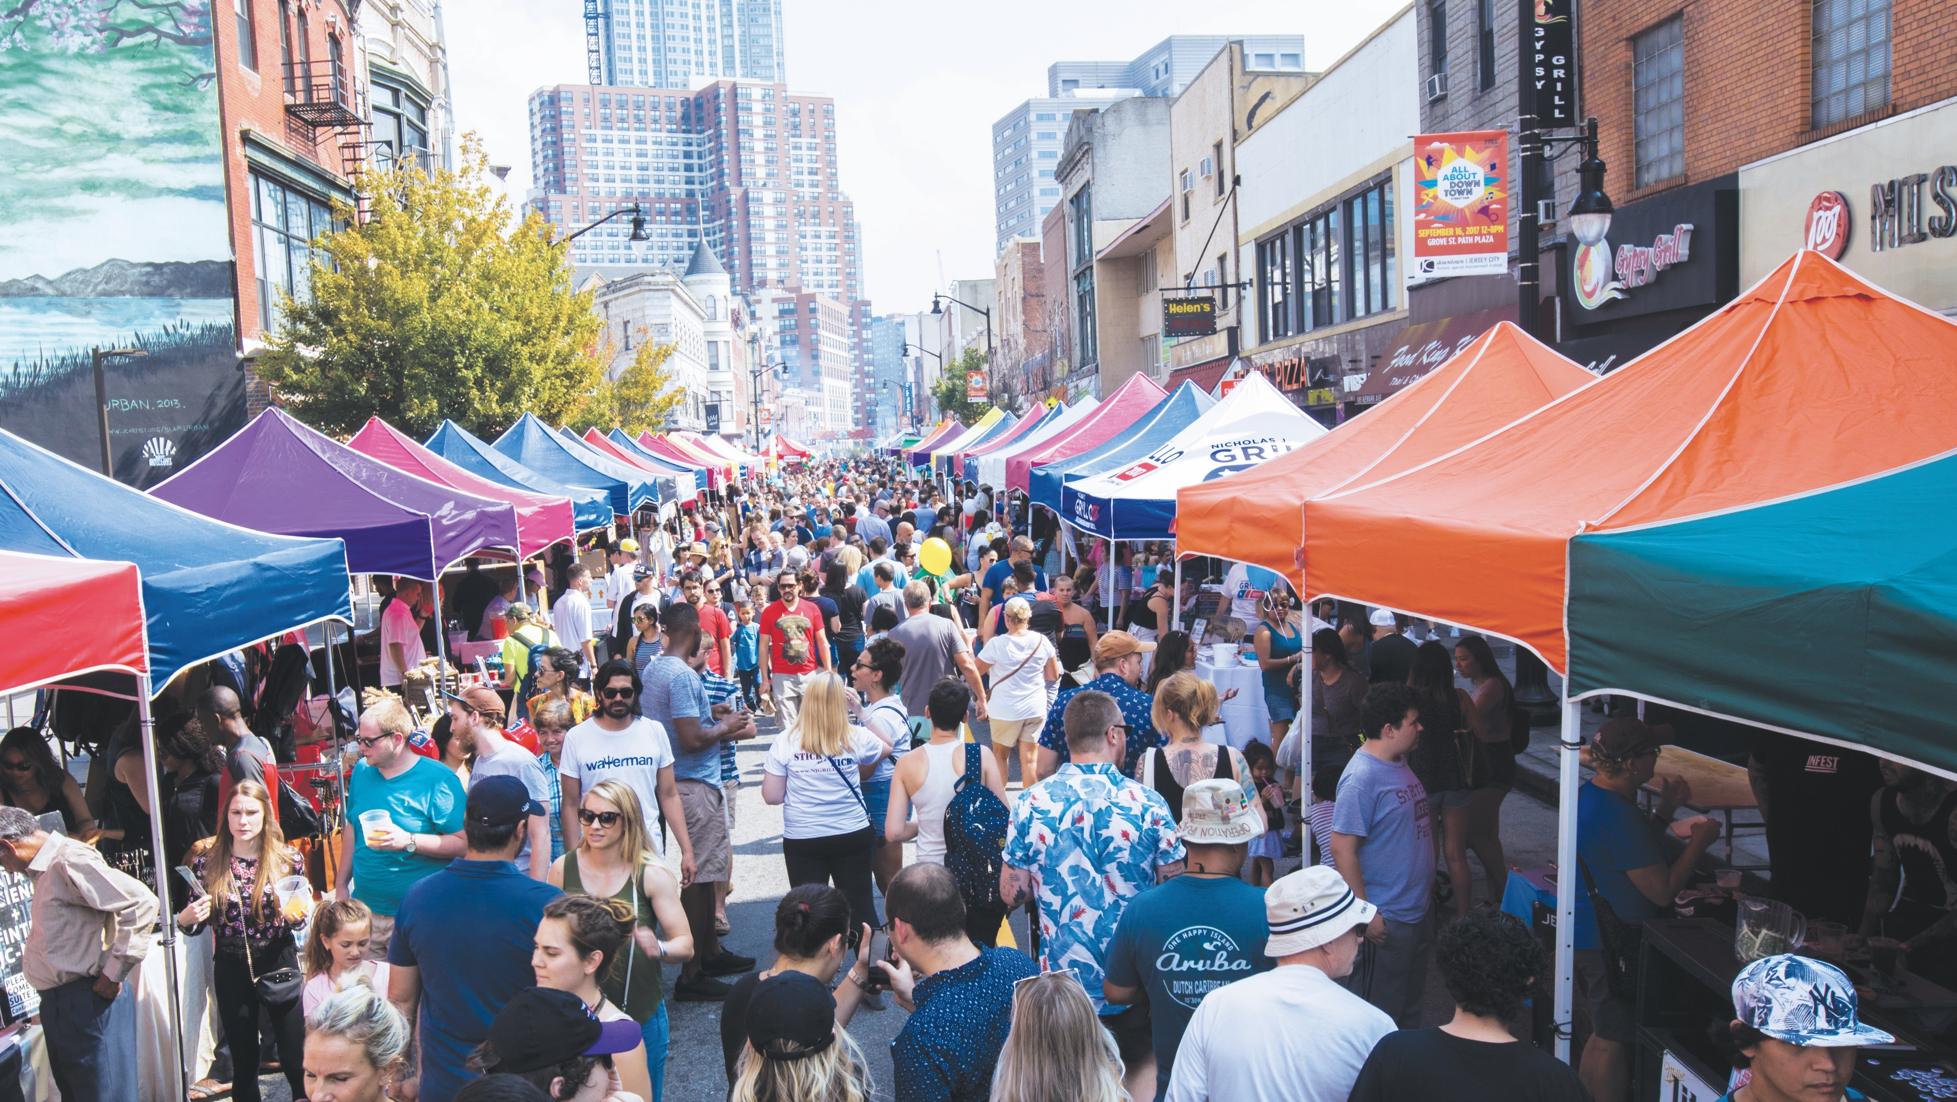
Visit www.njeda.com for more information
@NewJerseyEDA
Notes:
And that brings us to the end.
I know I covered a lot, so I am happy to answer any questions you have.
Thank you again for inviting me to speak.

